Slide 1
MPOPF Simulation and OpenDSS Validation
Aryan Ritwajeet Jha
Graduate Research Assistant
Washington State University
Notes:
Remember to hit the reset button to make sure all the page elements react properly.
There are 20 different layouts that you can choose from.

Slide 2
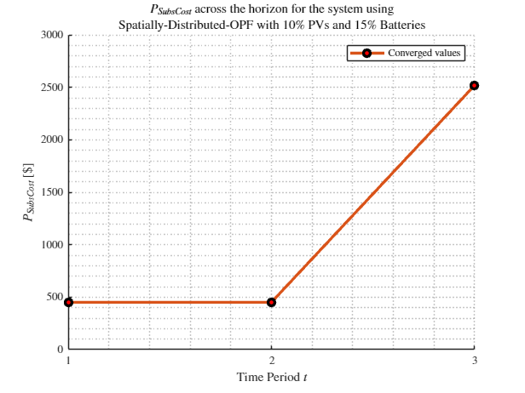
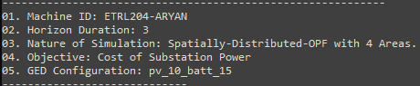
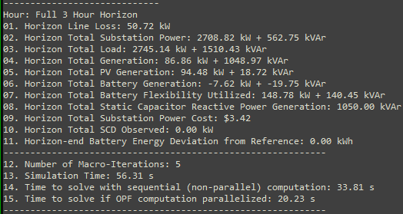
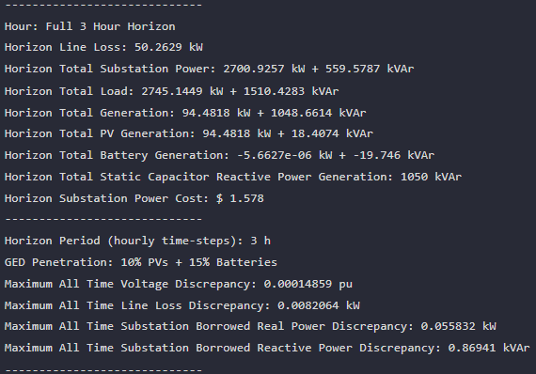

MPDOPF Verified for $T=3, PV=10\%, Batt=15\%$
strLoadShapeCost = 'New Loadshape.LoadShapeCost npts =3 interval = 1 mult = [0.048204 0.048204 0.30181]'
OpenDSS Def Profiles
Gen Cost
MPDOPF Simulation Results
OpenDSS Powerflow Results
Timings
Discrepancies

Slide 3
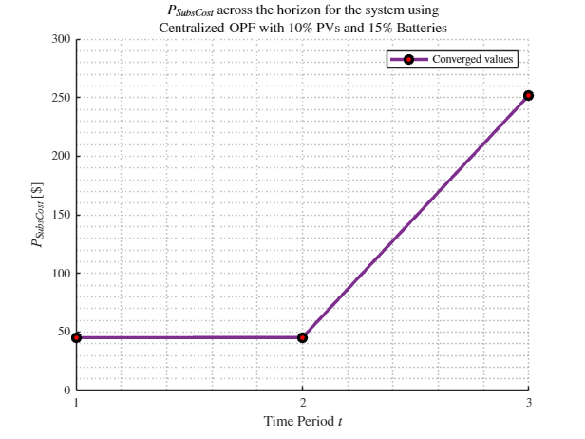
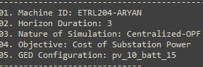
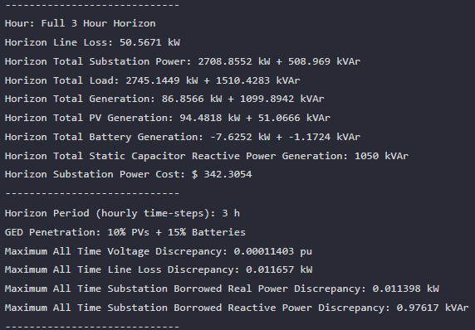
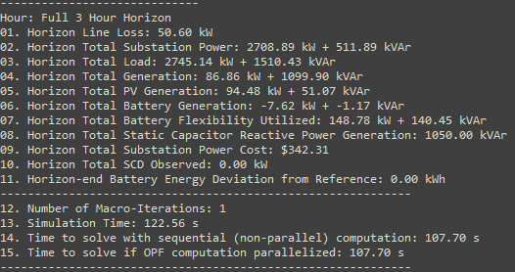

MPCOPF Verified for $T=3, PV=10\%, Batt=15\%$
strLoadShapeCost = 'New Loadshape.LoadShapeCost npts =3 interval = 1 mult = [0.048204 0.048204 0.30181]'
OpenDSS Def Profiles
Gen Cost
MPDOPF Simulation Results
OpenDSS Powerflow Results
Timings
Discrepancies

Slide 4
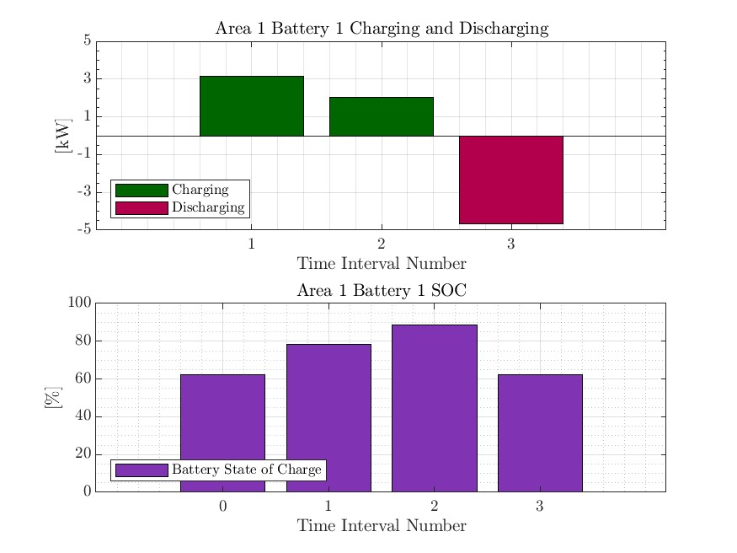
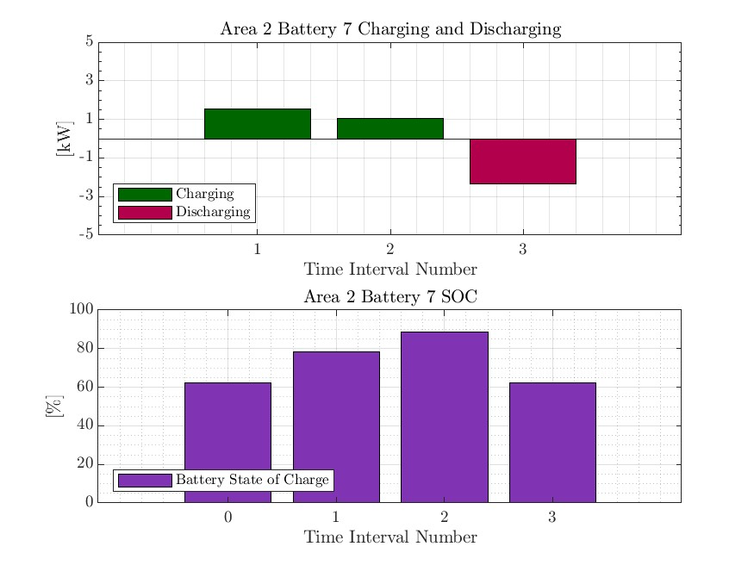
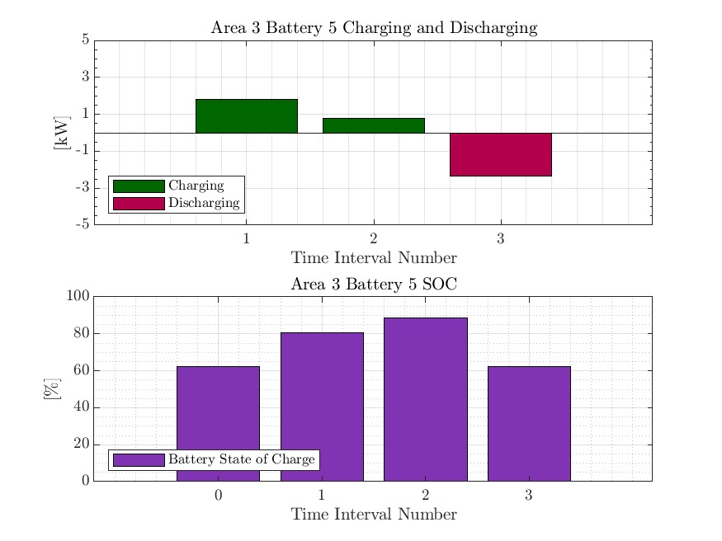
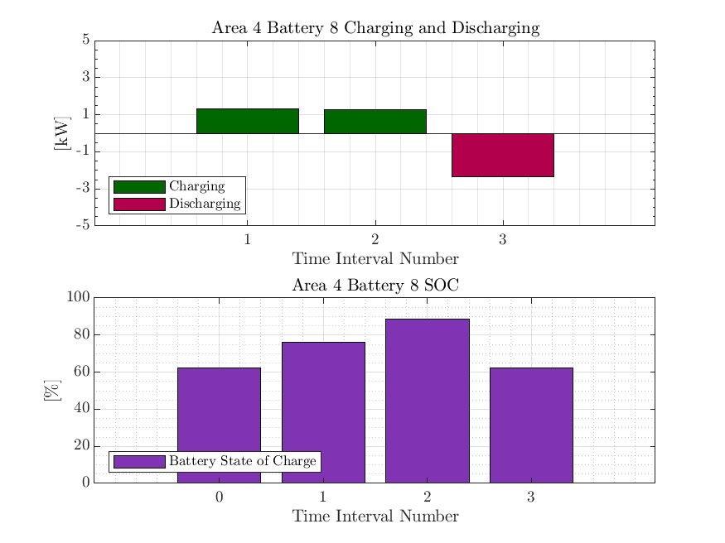

MPDOPF Verified for $T=3, PV=10\%, Batt=15\%$
strLoadShapeCost = 'New Loadshape.LoadShapeCost npts =3 interval = 1 mult = [0.048204 0.048204 0.30181]'
OpenDSS Def Profiles
Gen Cost

Slide 5
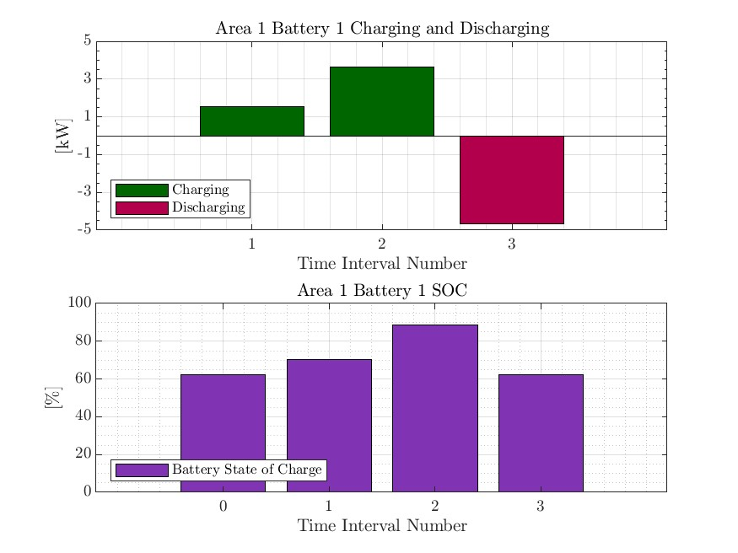

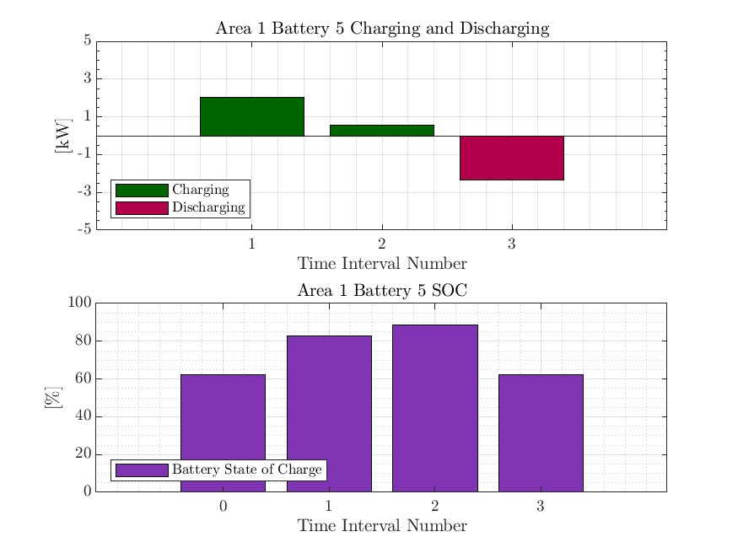


MPCOPF Verified for $T=3, PV=10\%, Batt=15\%$
strLoadShapeCost = 'New Loadshape.LoadShapeCost npts =3 interval = 1 mult = [0.048204 0.048204 0.30181]'
OpenDSS Def Profiles
Gen Cost

Slide 6
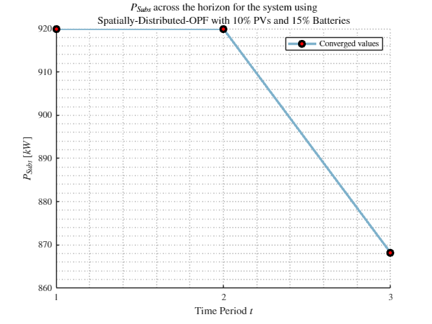
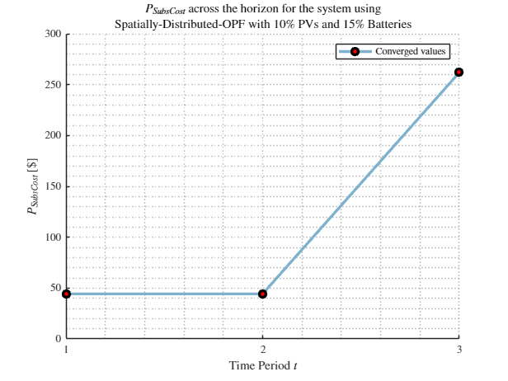
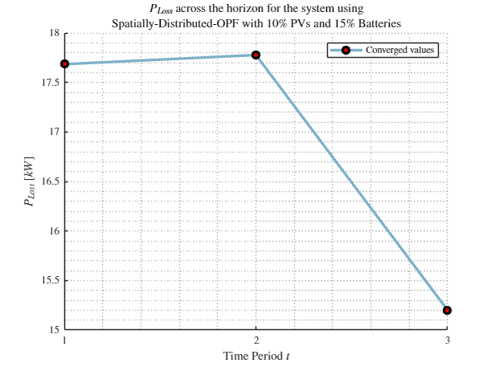
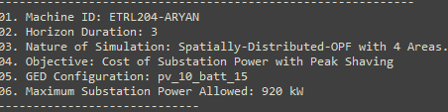
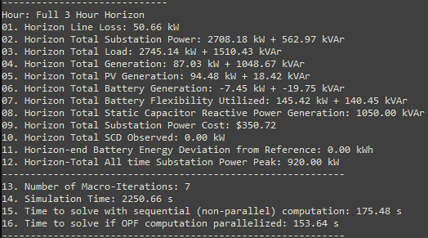
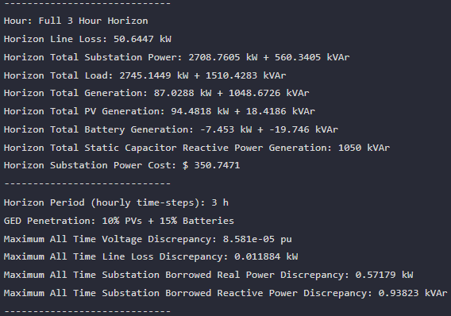



MPDOPF Verified for $T=3, PV=10\%, Batt=15\%$
strLoadShapeCost = 'New Loadshape.LoadShapeCost npts =3 interval = 1 mult = [0.048204 0.048204 0.30181]'
$P_{Subs}^{t}$
$P_{SubsCost}^{t}$
OpenDSS Def Profiles
Gen Cost + Peak Shave
OpenDSS Powerflow Results
$$P_{Loss}^{t}$$
MPDOPF Simulation Results
Timings
Discrepancies

Slide 7
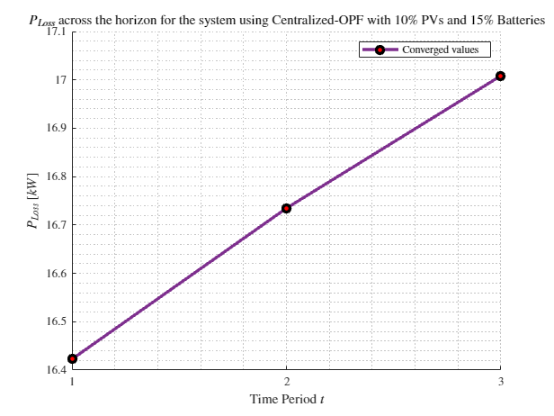
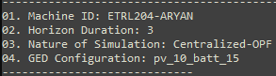
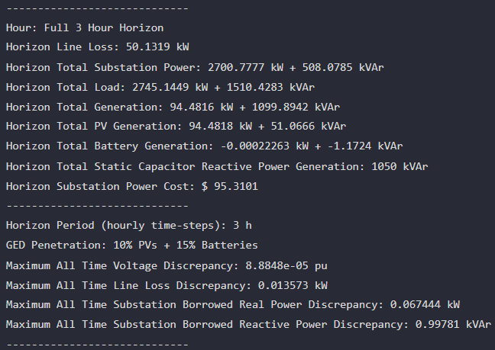
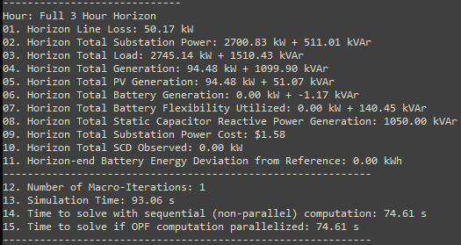
MPCOPF Verified for $T=3, PV=10\%, Batt=15\%$
strLoadShapeCost = 'New Loadshape.LoadShapeCost npts =3 interval = 1 mult = [0.048204 0.048204 0.30181]'
OpenDSS Def Profiles
Gen Cost + Peak Shave
MPDOPF Simulation Results
OpenDSS Powerflow Results
Timings
Discrepancies

Slide 8
MPDOPF Verified for $T=3, PV=10\%, Batt=15\%$
strLoadShapeCost = 'New Loadshape.LoadShapeCost npts =3 interval = 1 mult = [0.048204 0.048204 0.30181]'
OpenDSS Def Profiles
Gen Cost + Peak Shave

Slide 9
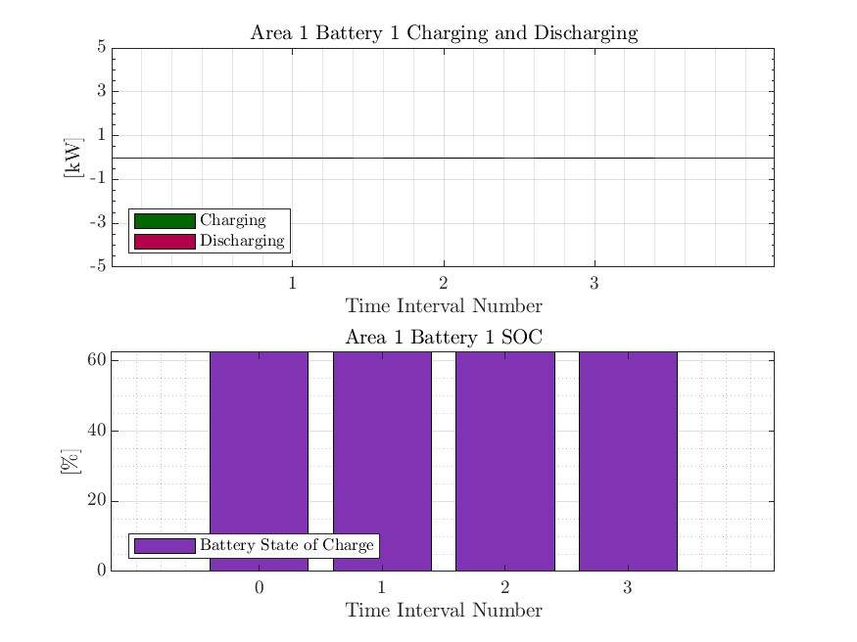



MPCOPF Verified for $T=3, PV=10\%, Batt=15\%$
strLoadShapeCost = 'New Loadshape.LoadShapeCost npts =3 interval = 1 mult = [0.048204 0.048204 0.30181]'
OpenDSS Def Profiles
Gen Cost + Peak Shave

Slide 10
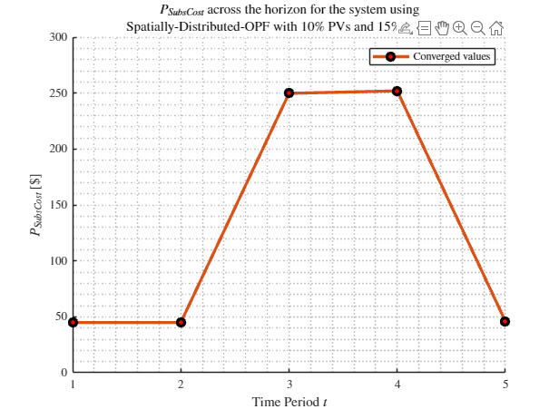
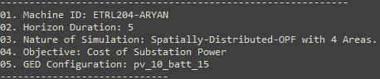
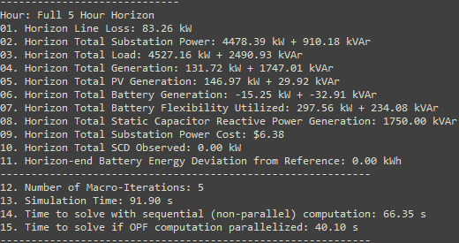
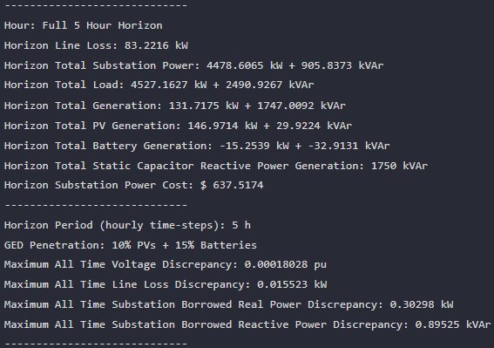

MPDOPF Verified for $T=5, PV=10\%, Batt=15\%$
strLoadShapeCost = 'New Loadshape.LoadShapeCost npts =5 interval = 1 mult = [0.048204 0.048204 0.30181 0.30181 0.048204]'
OpenDSS Def Profiles
Gen Cost
MPDOPF Simulation Results
OpenDSS Powerflow Results
Timings
Discrepancies

Slide 11
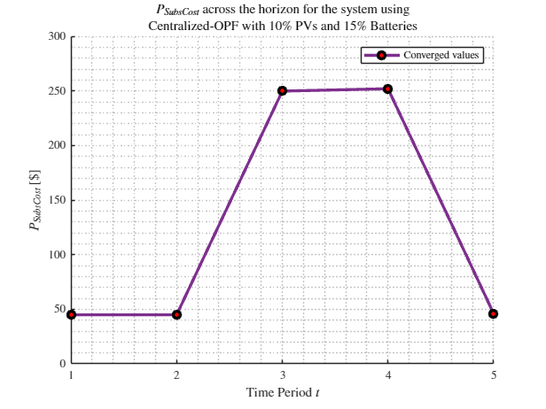
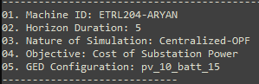
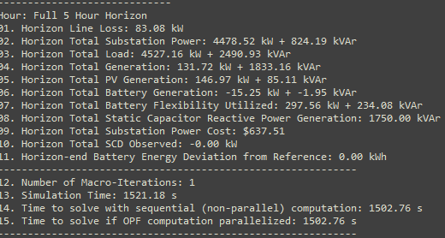

MPCOPF Verified for $T=5, PV=10\%, Batt=15\%$
strLoadShapeCost = 'New Loadshape.LoadShapeCost npts =5 interval = 1 mult = [0.048204 0.048204 0.30181 0.30181 0.048204]'
OpenDSS Def Profiles
Gen Cost
MPDOPF Simulation Results
OpenDSS Powerflow Results
Timings
Discrepancies

Slide 12
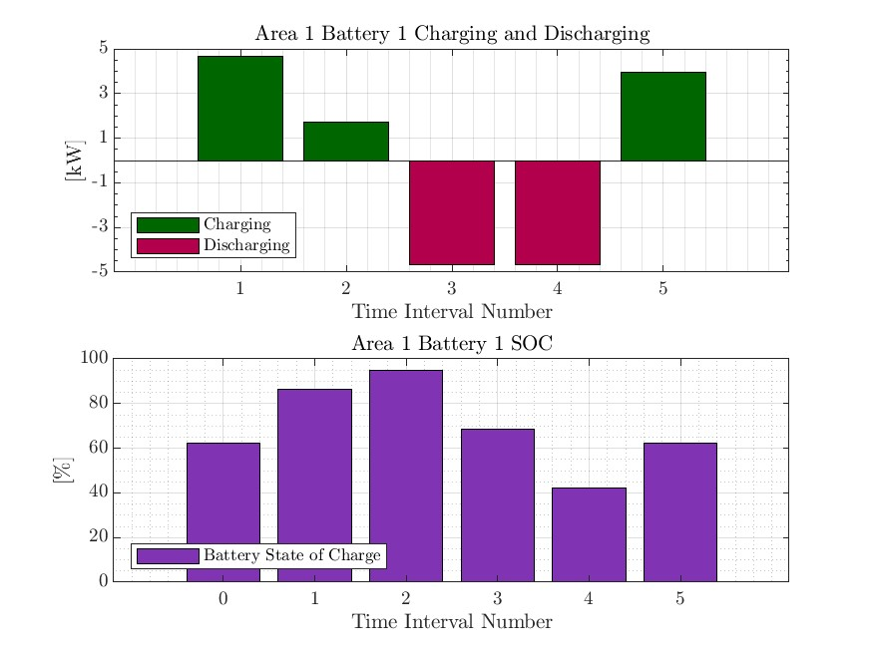
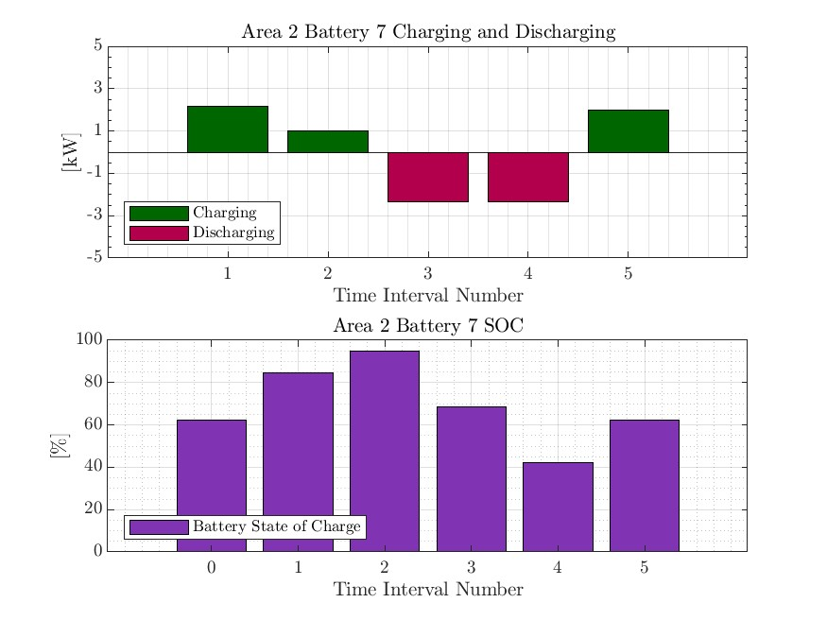

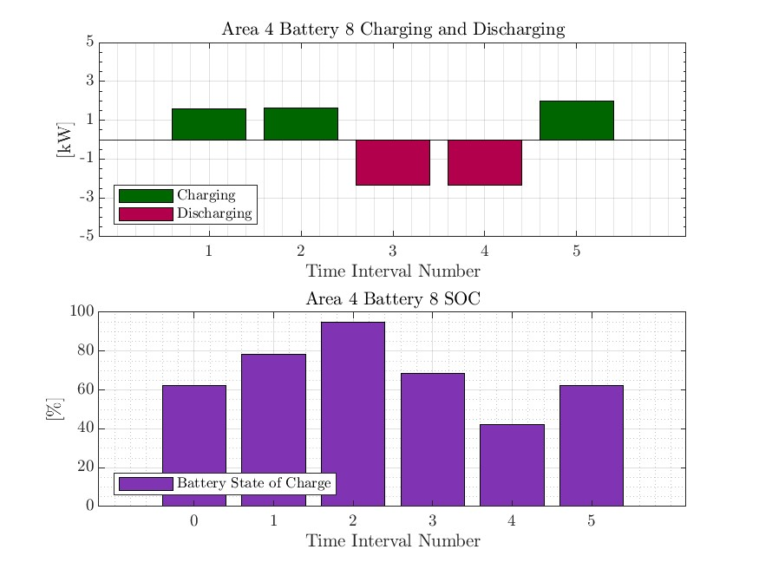

MPDOPF Verified for $T=5, PV=10\%, Batt=15\%$
strLoadShapeCost = 'New Loadshape.LoadShapeCost npts =5 interval = 1 mult = [0.048204 0.048204 0.30181 0.30181 0.048204]'
OpenDSS Def Profiles
Gen Cost

Slide 13
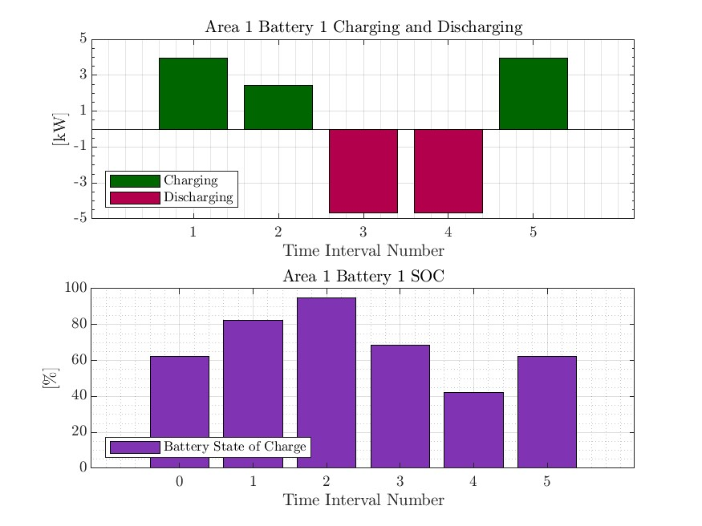
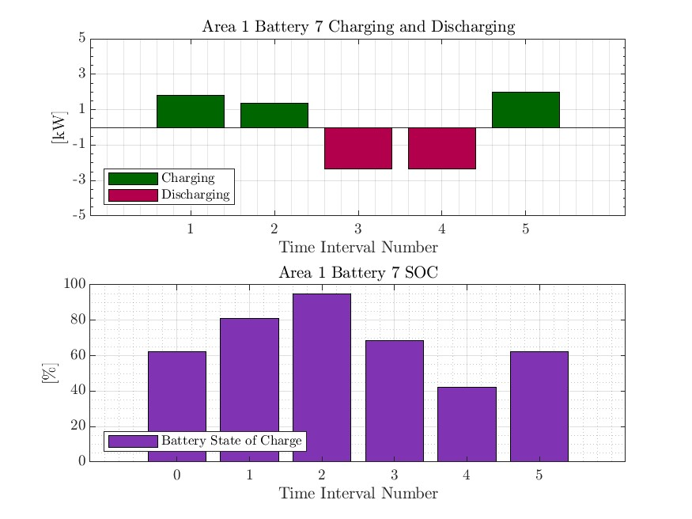



MPCOPF Verified for $T=5, PV=10\%, Batt=15\%$
strLoadShapeCost = 'New Loadshape.LoadShapeCost npts =5 interval = 1 mult = [0.048204 0.048204 0.30181 0.30181 0.048204]'
OpenDSS Def Profiles
Gen Cost

Slide 14
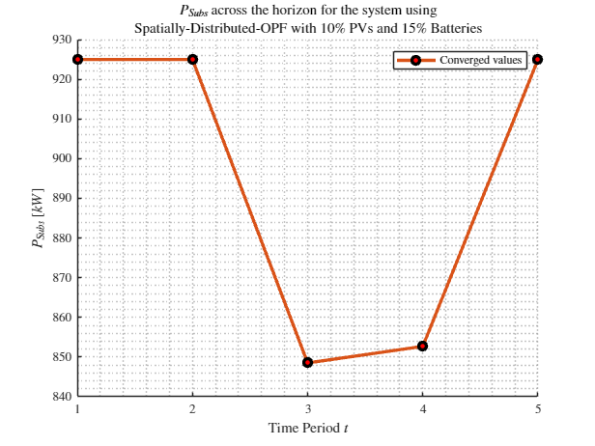

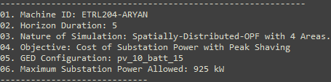
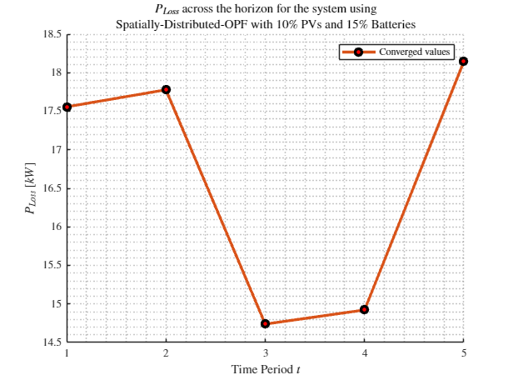

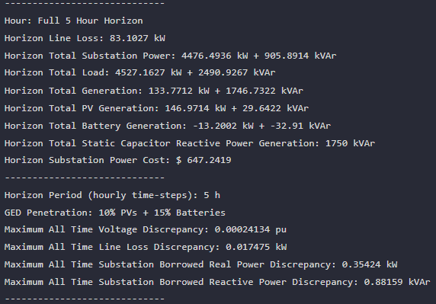
MPDOPF Verified for $T=5, PV=10\%, Batt=15\%$
strLoadShapeCost = 'New Loadshape.LoadShapeCost npts =5 interval = 1 mult = [0.048204 0.048204 0.30181 0.30181 0.048204]'
$P_{Subs}^{t}$
$P_{SubsCost}^{t}$
OpenDSS Def Profiles
Gen Cost + Peak Shave
OpenDSS Powerflow Results
$$P_{Loss}^{t}$$
MPDOPF Simulation Results
Timings
Discrepancies

Slide 15
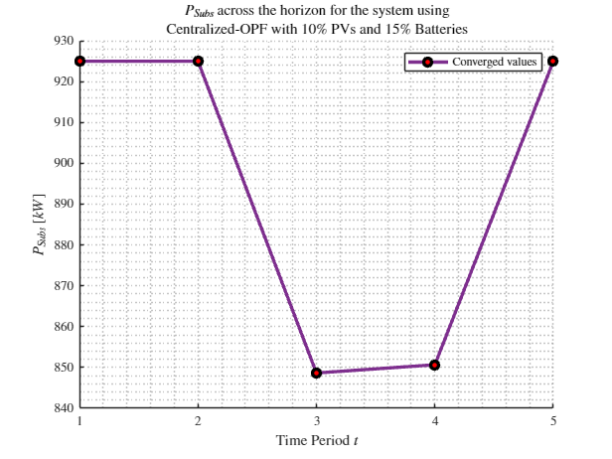
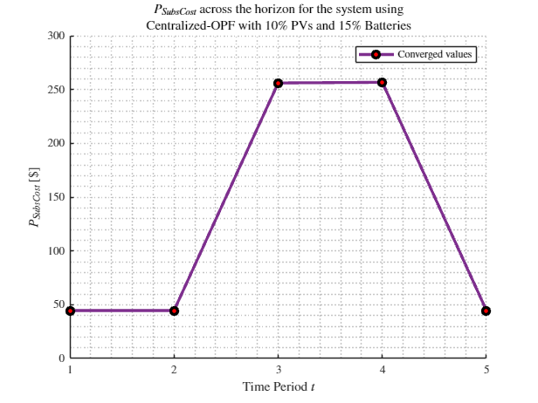
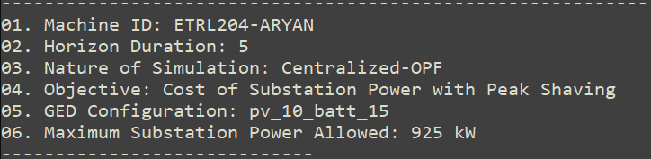
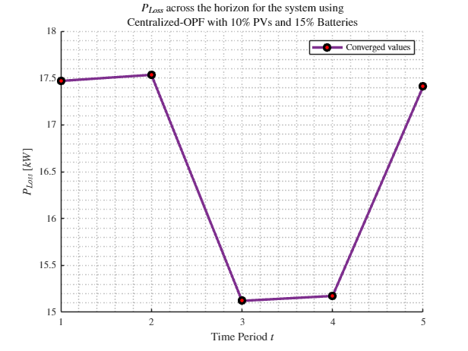
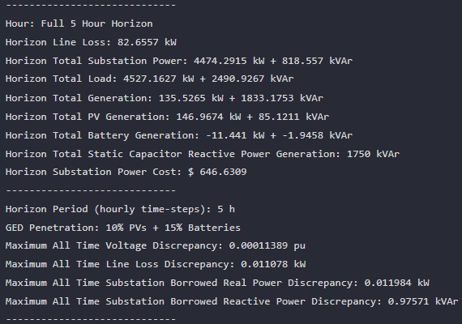
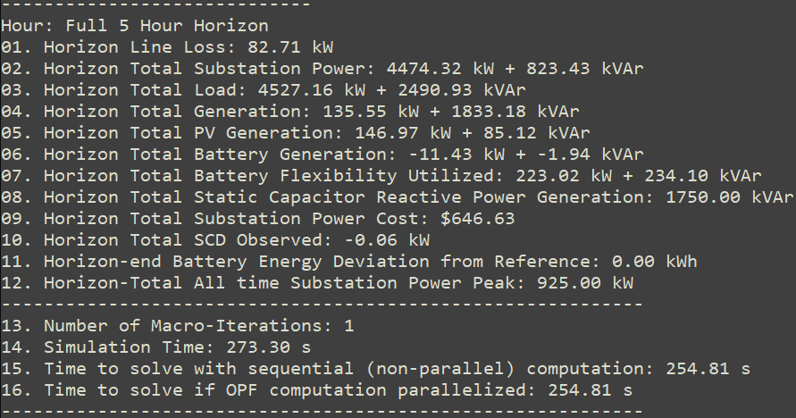
MPCOPF Verified for $T=5, PV=10\%, Batt=15\%$
strLoadShapeCost = 'New Loadshape.LoadShapeCost npts =5 interval = 1 mult = [0.048204 0.048204 0.30181 0.30181 0.048204]'
$P_{Subs}^{t}$
$P_{SubsCost}^{t}$
OpenDSS Def Profiles
Gen Cost + Peak Shave
OpenDSS Powerflow Results
$$P_{Loss}^{t}$$
MPDOPF Simulation Results
Discrepancies
Timings

Slide 16
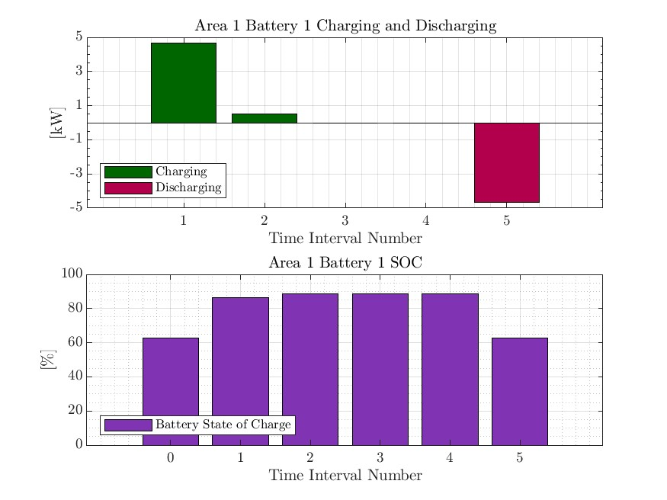



MPDOPF Verified for $T=5, PV=10\%, Batt=15\%$
strLoadShapeCost = 'New Loadshape.LoadShapeCost npts =5 interval = 1 mult = [0.048204 0.048204 0.30181 0.30181 0.048204]'
OpenDSS Def Profiles
Gen Cost + Peak Shave

Slide 17

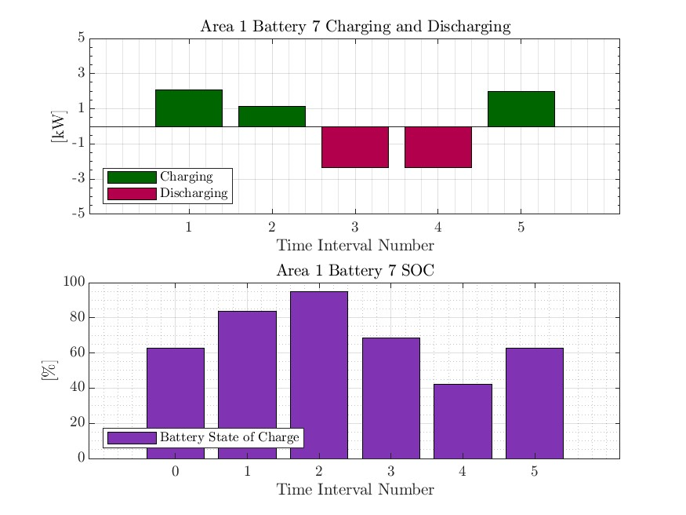


MPCOPF Verified for $T=5, PV=10\%, Batt=15\%$
strLoadShapeCost = 'New Loadshape.LoadShapeCost npts =5 interval = 1 mult = [0.048204 0.048204 0.30181 0.30181 0.048204]'
OpenDSS Def Profiles
Gen Cost + Peak Shave

Slide 18
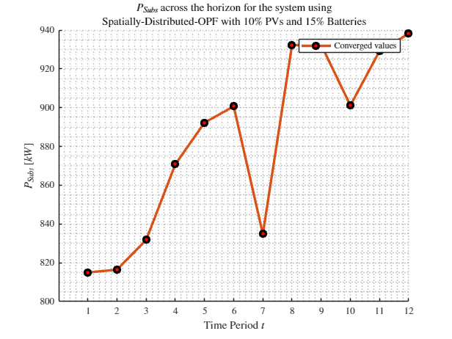



MPDOPF Verified for $T=12, PV=10\%, Batt=15\%$
$P_{Subs}^{t}$
$P_{SubsCost}^{t}$
OpenDSS Def Profiles
Gen Cost + Peak Shave
OpenDSS Powerflow Results
$$P_{Loss}^{t}$$
MPDOPF Simulation Results
Timings
Discrepancies

Slide 19

MPCOPF Verified for $T=12, PV=10\%, Batt=15\%$
$P_{Subs}^{t}$
$P_{SubsCost}^{t}$
OpenDSS Def Profiles
Gen Cost + Peak Shave
OpenDSS Powerflow Results
$$P_{Loss}^{t}$$
MPDOPF Simulation Results
Timings
Discrepancies

Slide 20

MPDOPF Verified for $T=12, PV=10\%, Batt=15\%$
OpenDSS Def Profiles
Gen Cost + Peak Shave

Slide 21

MPCOPF Verified for $T=12, PV=10\%, Batt=15\%$
OpenDSS Def Profiles
Gen Cost + Peak Shave

Slide 22
MPDOPF Verified for $T=3, PV=10\%, Batt=15\%$
strLoadShape = 'New Loadshape.LoadShape npts =3 interval = 1 mult = [0.777 0.787 0.796]'
strLoadShapePV = 'New Loadshape.LoadShapePV npts =3 interval = 1 mult = [0.8 0.9 1]'
$P_{Subs}^{t}$
$P_{SubsCost}^{t}$
OpenDSS Def Profiles
Gen Cost + Peak Shave
OpenDSS Powerflow Results
$$P_{Loss}^{t}$$
MPDOPF Simulation Results
Timings
Discrepancies

Slide 23
MPCOPF Verified for $T=3, PV=10\%, Batt=15\%$
$P_{Subs}^{t}$
$P_{SubsCost}^{t}$
OpenDSS Def Profiles
Gen Cost + Peak Shave
OpenDSS Powerflow Results
$$P_{Loss}^{t}$$
MPDOPF Simulation Results
Timings
Discrepancies

Slide 24
MPDOPF Verified for $T=3, PV=10\%, Batt=15\%$
OpenDSS Def Profiles
Gen Cost + Peak Shave

Slide 25
MPCOPF Verified for $T=3, PV=10\%, Batt=15\%$
OpenDSS Def Profiles
Gen Cost + Peak Shave

Slide 26

Latest Slides End Here.
Previous Slides Follow

Slide 27





MPDOPF Verified for $T=2, PV=10\%, Batt=15\%$
strLoadShape = 'New Loadshape.LoadShape npts =2 interval = 1 mult = [1 0.7]'
strLoadShapePV = 'New Loadshape.LoadShapePV npts =2 interval = 1 mult = [1.4 0.8]'
MPDOPF Simulation Results
Alternative Profiles
OpenDSS Powerflow Results

Slide 28





MPCOPF Verified for $T=2, PV=10\%, Batt=15\%$
strLoadShape = 'New Loadshape.LoadShape npts =2 interval = 1 mult = [1 0.7]'
strLoadShapePV = 'New Loadshape.LoadShapePV npts =2 interval = 1 mult = [1.4 0.8]'
MPCOPF Simulation Results
Alternative Profiles
OpenDSS Powerflow Results

Slide 29





MPDOPF Verified for $T=2, PV=10\%, Batt=15\%$
strLoadShape = 'New Loadshape.LoadShape npts =2 interval = 1 mult = [1 0.7]'
strLoadShapePV = 'New Loadshape.LoadShapePV npts =2 interval = 1 mult = [1.4 0.8]'
Alternative Profiles

Slide 30




MPCOPF Verified for $T=2, PV=10\%, Batt=15\%$
strLoadShape = 'New Loadshape.LoadShape npts =2 interval = 1 mult = [1 0.7]'
strLoadShapePV = 'New Loadshape.LoadShapePV npts =2 interval = 1 mult = [1.4 0.8]'
Alternative Profiles

Slide 31




Boundary Complex Powers
strLoadShape = 'New Loadshape.LoadShape npts =2 interval = 1 mult = [1 0.7]'
MPDOPF Verified for $T=2, PV=10\%, Batt=15\%$
strLoadShapePV = 'New Loadshape.LoadShapePV npts =2 interval = 1 mult = [1.4 0.8]'
Alternative Profiles

Slide 32



Boundary Voltages
strLoadShape = 'New Loadshape.LoadShape npts =2 interval = 1 mult = [1 0.7]'
MPDOPF Verified for $T=2, PV=10\%, Batt=15\%$
strLoadShapePV = 'New Loadshape.LoadShapePV npts =2 interval = 1 mult = [1.4 0.8]'
Alternative Profiles

Slide 33



MPDOPF Verified for $T=3, PV=10\%, Batt=15\%$
strLoadShape = 'New Loadshape.LoadShape npts =3 interval = 1 mult = [0.777 0.787 0.796]'
strLoadShapePV = 'New Loadshape.LoadShapePV npts =3 interval = 1 mult = [0.8 0.9 1]'
MPDOPF Simulation Results
OpenDSS Powerflow Results
OpenDSS Def Profiles

Slide 34
MPCOPF Verified for $T=3, PV=10\%, Batt=15\%$
strLoadShape = 'New Loadshape.LoadShape npts =3 interval = 1 mult = [0.777 0.787 0.796]'
strLoadShapePV = 'New Loadshape.LoadShapePV npts =3 interval = 1 mult = [0.8 0.9 1]'
MPDOPF Simulation Results
OpenDSS Powerflow Results
OpenDSS Def Profiles

Slide 35



MPDOPF Verified for $T=3, PV=10\%, Batt=15\%$
strLoadShape = 'New Loadshape.LoadShape npts =3 interval = 1 mult = [0.777 0.787 0.796]'
strLoadShapePV = 'New Loadshape.LoadShapePV npts =3 interval = 1 mult = [0.8 0.9 1]'
OpenDSS Def Profiles

Slide 36
MPCOPF Verified for $T=3, PV=10\%, Batt=15\%$
strLoadShape = 'New Loadshape.LoadShape npts =3 interval = 1 mult = [0.777 0.787 0.796]'
strLoadShapePV = 'New Loadshape.LoadShapePV npts =3 interval = 1 mult = [0.8 0.9 1]'
OpenDSS Def Profiles

Slide 37




Boundary Complex Powers
strLoadShape = 'New Loadshape.LoadShape npts =3 interval = 1 mult = [0.777 0.787 0.796]'
MPDOPF Verified for $T=3, PV=10\%, Batt=15\%$
strLoadShapePV = 'New Loadshape.LoadShapePV npts =3 interval = 1 mult = [0.8 0.9 1]'
OpenDSS Def Profiles

Slide 38



Boundary Voltages
strLoadShape = 'New Loadshape.LoadShape npts =3 interval = 1 mult = [0.777 0.787 0.796]'
MPDOPF Verified for $T=3, PV=10\%, Batt=15\%$
strLoadShapePV = 'New Loadshape.LoadShapePV npts =3 interval = 1 mult = [0.8 0.9 1]'
OpenDSS Def Profiles

Slide 39




MPDOPF Verified for $T=3, PV=10\%, Batt=15\%$
strLoadShape = 'New Loadshape.LoadShape npts =3 interval = 1 mult = [0.7 1 0.7]'
strLoadShapePV = 'New Loadshape.LoadShapePV npts =3 interval = 1 mult = [0.8 1 0.8]'
MPDOPF Simulation Results
Alternative Profiles
OpenDSS Powerflow Results

Slide 40





MPCOPF Verified for $T=3, PV=10\%, Batt=15\%$
strLoadShape = 'New Loadshape.LoadShape npts =3 interval = 1 mult = [0.7 1 0.7]'
strLoadShapePV = 'New Loadshape.LoadShapePV npts =3 interval = 1 mult = [0.8 1 0.8]'
MPCOPF Simulation Results
Alternative Profiles
OpenDSS Powerflow Results

Slide 41




MPDOPF Verified for $T=3, PV=10\%, Batt=15\%$
strLoadShape = 'New Loadshape.LoadShape npts =3 interval = 1 mult = [0.7 1 0.7]'
strLoadShapePV = 'New Loadshape.LoadShapePV npts =3 interval = 1 mult = [0.8 1 0.8]'
Alternative Profiles

Slide 42



MPCOPF Verified for $T=3, PV=10\%, Batt=15\%$
strLoadShape = 'New Loadshape.LoadShape npts =3 interval = 1 mult = [0.7 1 0.7]'
strLoadShapePV = 'New Loadshape.LoadShapePV npts =3 interval = 1 mult = [0.8 1 0.8]'
Alternative Profiles

Slide 43



Boundary Complex Powers
strLoadShape = 'New Loadshape.LoadShape npts =3 interval = 1 mult = [0.7 1 0.7]'
MPDOPF Verified for $T=3, PV=10\%, Batt=15\%$
strLoadShapePV = 'New Loadshape.LoadShapePV npts =3 interval = 1 mult = [0.8 1 0.8]'
Alternative Profiles

Slide 44



Boundary Voltages
strLoadShape = 'New Loadshape.LoadShape npts =3 interval = 1 mult = [0.7 1 0.7]'
MPDOPF Verified for $T=3, PV=10\%, Batt=15\%$
strLoadShapePV = 'New Loadshape.LoadShapePV npts =3 interval = 1 mult = [0.8 1 0.8]'
Alternative Profiles

Slide 45





MPDOPF Verified for $T=5, PV=10\%, Batt=15\%$
strLoadShape = 'New Loadshape.LoadShape npts =5 interval = 1 mult = [0.75 0.777 0.787 0.796 0.782]'
strLoadShapePV = 'New Loadshape.LoadShapePV npts =5 interval = 1 mult = [0.5 0.8 0.9 1 1]'
MPDOPF Simulation Results
OpenDSS Powerflow Results

Slide 46





MPCOPF Verified for $T=5, PV=10\%, Batt=15\%$
strLoadShape = 'New Loadshape.LoadShape npts =5 interval = 1 mult = [0.75 0.777 0.787 0.796 0.782]'
strLoadShapePV = 'New Loadshape.LoadShapePV npts =5 interval = 1 mult = [0.5 0.8 0.9 1 1]'
MPCOPF Simulation Results
OpenDSS Powerflow Results

Slide 47




Boundary Complex Powers
MPDOPF Verified for $T=5, PV=10\%, Batt=15\%$

Slide 48



Boundary Voltages
MPDOPF Verified for $T=5, PV=10\%, Batt=15\%$

Slide 49




MPDOPF Verified for $T=5, PV=10\%, Batt=15\%$
strLoadShape = 'New Loadshape.LoadShape npts =5 interval = 1 mult = [0.7 0.85 1 0.85 0.7]'
strLoadShapePV = 'New Loadshape.LoadShapePV npts =5 interval = 1 mult = [1 1.2828 1.4 1.1 0.8]'
MPDOPF Simulation Results
Alternative Profiles
OpenDSS Powerflow Results

Slide 50




MPCOPF Verified for $T=5, PV=10\%, Batt=15\%$
strLoadShape = 'New Loadshape.LoadShape npts =5 interval = 1 mult = [0.7 0.85 1 0.85 0.7]'
strLoadShapePV = 'New Loadshape.LoadShapePV npts =5 interval = 1 mult = [1 1.2828 1.4 1.1 0.8]'
MPCOPF Simulation Results
Alternative Profiles
OpenDSS Powerflow Results

Slide 51




MPDOPF Verified for $T=5, PV=10\%, Batt=15\%$
strLoadShape = 'New Loadshape.LoadShape npts =5 interval = 1 mult = [0.7 0.85 1 0.85 0.7]'
strLoadShapePV = 'New Loadshape.LoadShapePV npts =5 interval = 1 mult = [1 1.2828 1.4 1.1 0.8]'
Alternative Profiles

Slide 52




MPCOPF Verified for $T=5, PV=10\%, Batt=15\%$
strLoadShape = 'New Loadshape.LoadShape npts =5 interval = 1 mult = [0.7 0.85 1 0.85 0.7]'
strLoadShapePV = 'New Loadshape.LoadShapePV npts =5 interval = 1 mult = [1 1.2828 1.4 1.1 0.8]'
Alternative Profiles

Slide 53



Boundary Complex Powers
strLoadShape = 'New Loadshape.LoadShape npts =5 interval = 1 mult = [0.7 0.85 1 0.85 0.7]'
MPDOPF Verified for $T=5, PV=10\%, Batt=15\%$
strLoadShapePV = 'New Loadshape.LoadShapePV npts =5 interval = 1 mult = [1 1.2828 1.4 1.1 0.8]'
Alternative Profiles

Slide 54



Boundary Voltages
strLoadShape = 'New Loadshape.LoadShape npts =5 interval = 1 mult = [0.7 0.85 1 0.85 0.7]'
MPDOPF Verified for $T=5, PV=10\%, Batt=15\%$
strLoadShapePV = 'New Loadshape.LoadShapePV npts =5 interval = 1 mult = [1 1.2828 1.4 1.1 0.8]'
Alternative Profiles

Slide 55


MPDOPF Verified for $T=8, PV=10\%, Batt=15\%$
strLoadShape = 'New Loadshape.LoadShape npts =8 interval = 1 mult = [0.705 0.75 0.777 0.787 0.796 0.782 0.783 0.789]'
strLoadShapePV = 'New Loadshape.LoadShapePV npts =8 interval = 1 mult = [0.3 0.5 0.8 0.9 1 1 0.99 0.9]'
MPDOPF Simulation Results
OpenDSS Powerflow Results

Slide 56





MPCOPF Verified for $T=8, PV=10\%, Batt=15\%$
strLoadShape = 'New Loadshape.LoadShape npts =8 interval = 1 mult = [0.705 0.75 0.777 0.787 0.796 0.782 0.783 0.789]'
strLoadShapePV = 'New Loadshape.LoadShapePV npts =8 interval = 1 mult = [0.3 0.5 0.8 0.9 1 1 0.99 0.9]'
MPCOPF Simulation Results
OpenDSS Powerflow Results

Slide 57

MPDOPF Verified for $T=8, PV=10\%, Batt=15\%$
strLoadShape = 'New Loadshape.LoadShape npts =8 interval = 1 mult = [0.705 0.75 0.777 0.787 0.796 0.782 0.783 0.789]'
1, 5, 7, 8 in COPF values
strLoadShapePV = 'New Loadshape.LoadShapePV npts =8 interval = 1 mult = [0.3 0.5 0.8 0.9 1 1 0.99 0.9]'

Slide 58





MPCOPF Verified for $T=8, PV=10\%, Batt=15\%$
strLoadShape = 'New Loadshape.LoadShape npts =8 interval = 1 mult = [0.705 0.75 0.777 0.787 0.796 0.782 0.783 0.789]'
strLoadShapePV = 'New Loadshape.LoadShapePV npts =8 interval = 1 mult = [0.3 0.5 0.8 0.9 1 1 0.99 0.9]'

Slide 59




Boundary Complex Powers
strLoadShape = 'New Loadshape.LoadShape npts =8 interval = 1 mult = [0.705 0.75 0.777 0.787 0.796 0.782 0.783 0.789]'
MPDOPF Verified for $T=8, PV=10\%, Batt=15\%$
strLoadShapePV = 'New Loadshape.LoadShapePV npts =8 interval = 1 mult = [0.3 0.5 0.8 0.9 1 1 0.99 0.9]'

Slide 60



Boundary Voltages
strLoadShape = 'New Loadshape.LoadShape npts =8 interval = 1 mult = [0.705 0.75 0.777 0.787 0.796 0.782 0.783 0.789]'
MPDOPF Verified for $T=8, PV=10\%, Batt=15\%$
strLoadShapePV = 'New Loadshape.LoadShapePV npts =8 interval = 1 mult = [0.3 0.5 0.8 0.9 1 1 0.99 0.9]'

Slide 61





MPDOPF Verified for $T=9, PV=10\%, Batt=15\%$
strLoadShape = 'New Loadshape.LoadShape npts =9 interval = 1 mult = [0.668 0.705 0.75 0.777 0.787 0.796 0.782 0.783 0.789]'
strLoadShapePV = 'New Loadshape.LoadShapePV npts =9 interval = 1 mult = [0.2 0.3 0.5 0.8 0.9 1 1 0.99 0.9]'
MPDOPF Simulation Results
OpenDSS Powerflow Results

Slide 62





MPCOPF Verified for $T=9, PV=10\%, Batt=15\%$
strLoadShape = 'New Loadshape.LoadShape npts =9 interval = 1 mult = [0.668 0.705 0.75 0.777 0.787 0.796 0.782 0.783 0.789]'
strLoadShapePV = 'New Loadshape.LoadShapePV npts =9 interval = 1 mult = [0.2 0.3 0.5 0.8 0.9 1 1 0.99 0.9]'
MPCOPF Simulation Results
OpenDSS Powerflow Results

Slide 63








MPDOPF Verified for $T=9, PV=10\%, Batt=15\%$
strLoadShape = 'New Loadshape.LoadShape npts =9 interval = 1 mult = [0.668 0.705 0.75 0.777 0.787 0.796 0.782 0.783 0.789]'
strLoadShapePV = 'New Loadshape.LoadShapePV npts =9 interval = 1 mult = [0.2 0.3 0.5 0.8 0.9 1 1 0.99 0.9]'

Slide 64








MPCOPF Verified for $T=9, PV=10\%, Batt=15\%$
strLoadShape = 'New Loadshape.LoadShape npts =9 interval = 1 mult = [0.668 0.705 0.75 0.777 0.787 0.796 0.782 0.783 0.789]'
strLoadShapePV = 'New Loadshape.LoadShapePV npts =9 interval = 1 mult = [0.2 0.3 0.5 0.8 0.9 1 1 0.99 0.9]'

Slide 65




Boundary Complex Powers
strLoadShape = 'New Loadshape.LoadShape npts =9 interval = 1 mult = [0.668 0.705 0.75 0.777 0.787 0.796 0.782 0.783 0.789]'
MPDOPF Verified for $T=9, PV=10\%, Batt=15\%$
strLoadShapePV = 'New Loadshape.LoadShapePV npts =9 interval = 1 mult = [0.2 0.3 0.5 0.8 0.9 1 1 0.99 0.9]'

Slide 66



Boundary Voltages
strLoadShape = 'New Loadshape.LoadShape npts =9 interval = 1 mult = [0.668 0.705 0.75 0.777 0.787 0.796 0.782 0.783 0.789]'
MPDOPF Verified for $T=9, PV=10\%, Batt=15\%$
strLoadShapePV = 'New Loadshape.LoadShapePV npts =9 interval = 1 mult = [0.2 0.3 0.5 0.8 0.9 1 1 0.99 0.9]'

Slide 67





MPDOPF Verified for $T=10, PV=10\%, Batt=15\%$
strLoadShape = 'New Loadshape.LoadShape npts =10 interval = 1 mult = [0.668 0.705 0.75 0.777 0.787 0.796 0.782 0.783 0.789 0.826]'
strLoadShapePV = 'New Loadshape.LoadShapePV npts =10 interval = 1 mult = [0.2 0.3 0.5 0.8 0.9 1 1 0.99 0.9 0.7]'
MPDOPF Simulation Results
OpenDSS Powerflow Results

Slide 68





MPCOPF Verified for $T=10, PV=10\%, Batt=15\%$
strLoadShape = 'New Loadshape.LoadShape npts =10 interval = 1 mult = [0.668 0.705 0.75 0.777 0.787 0.796 0.782 0.783 0.789 0.826]'
strLoadShapePV = 'New Loadshape.LoadShapePV npts =10 interval = 1 mult = [0.2 0.3 0.5 0.8 0.9 1 1 0.99 0.9 0.7]'
MPCOPF Simulation Results
OpenDSS Powerflow Results

Slide 69





MPDOPF Verified for $T=10, PV=10\%, Batt=15\%$
strLoadShape = 'New Loadshape.LoadShape npts =10 interval = 1 mult = [0.668 0.705 0.75 0.777 0.787 0.796 0.782 0.783 0.789 0.826]'
strLoadShapePV = 'New Loadshape.LoadShapePV npts =10 interval = 1 mult = [0.2 0.3 0.5 0.8 0.9 1 1 0.99 0.9 0.7]'

Slide 70





MPCOPF Verified for $T=10, PV=10\%, Batt=15\%$
strLoadShape = 'New Loadshape.LoadShape npts =10 interval = 1 mult = [0.668 0.705 0.75 0.777 0.787 0.796 0.782 0.783 0.789 0.826]'
strLoadShapePV = 'New Loadshape.LoadShapePV npts =10 interval = 1 mult = [0.2 0.3 0.5 0.8 0.9 1 1 0.99 0.9 0.7]'

Slide 71




Boundary Complex Powers
MPDOPF Verified for $T=10, PV=10\%, Batt=15\%$

Slide 72



Boundary Voltages
MPDOPF Verified for $T=10, PV=10\%, Batt=15\%$

Slide 73





MPDOPF Verified for $T=11, PV=10\%, Batt=15\%$
strLoadShape = 'New Loadshape.LoadShape npts =11 interval = 1 mult = [0.644 0.668 0.705 0.75 0.777 0.787 0.796 0.782 0.783 0.789 0.826]'
strLoadShapePV = 'New Loadshape.LoadShapePV npts =11 interval = 1 mult = [0.1 0.2 0.3 0.5 0.8 0.9 1 1 0.99 0.9 0.7]'
MPDOPF Simulation Results
OpenDSS Powerflow Results
OpenDSS Def Profiles

Slide 74

MPCOPF Verified for $T=11, PV=10\%, Batt=15\%$
strLoadShape = 'New Loadshape.LoadShape npts =11 interval = 1 mult = [0.644 0.668 0.705 0.75 0.777 0.787 0.796 0.782 0.783 0.789 0.826]'
strLoadShapePV = 'New Loadshape.LoadShapePV npts =11 interval = 1 mult = [0.1 0.2 0.3 0.5 0.8 0.9 1 1 0.99 0.9 0.7]'
MPDOPF Simulation Results
OpenDSS Powerflow Results
OpenDSS Def Profiles

Slide 75





MPDOPF Verified for $T=11, PV=10\%, Batt=15\%$
strLoadShape = 'New Loadshape.LoadShape npts =11 interval = 1 mult = [0.644 0.668 0.705 0.75 0.777 0.787 0.796 0.782 0.783 0.789 0.826]'
strLoadShapePV = 'New Loadshape.LoadShapePV npts =11 interval = 1 mult = [0.1 0.2 0.3 0.5 0.8 0.9 1 1 0.99 0.9 0.7]'
OpenDSS Def Profiles

Slide 76

MPCOPF Verified for $T=11, PV=10\%, Batt=15\%$
strLoadShape = 'New Loadshape.LoadShape npts =11 interval = 1 mult = [0.644 0.668 0.705 0.75 0.777 0.787 0.796 0.782 0.783 0.789 0.826]'
strLoadShapePV = 'New Loadshape.LoadShapePV npts =11 interval = 1 mult = [0.1 0.2 0.3 0.5 0.8 0.9 1 1 0.99 0.9 0.7]'
OpenDSS Def Profiles

Slide 77




Boundary Complex Powers
strLoadShape = 'New Loadshape.LoadShape npts =11 interval = 1 mult = [0.644 0.668 0.705 0.75 0.777 0.787 0.796 0.782 0.783 0.789 0.826]'
MPDOPF Verified for $T=11, PV=10\%, Batt=15\%$
strLoadShapePV = 'New Loadshape.LoadShapePV npts =11 interval = 1 mult = [0.1 0.2 0.3 0.5 0.8 0.9 1 1 0.99 0.9 0.7]'
OpenDSS Def Profiles

Slide 78



Boundary Voltages
strLoadShape = 'New Loadshape.LoadShape npts =11 interval = 1 mult = [0.644 0.668 0.705 0.75 0.777 0.787 0.796 0.782 0.783 0.789 0.826]'
MPDOPF Verified for $T=11, PV=10\%, Batt=15\%$
strLoadShapePV = 'New Loadshape.LoadShapePV npts =11 interval = 1 mult = [0.1 0.2 0.3 0.5 0.8 0.9 1 1 0.99 0.9 0.7]'
OpenDSS Def Profiles

Slide 79




MPDOPF Verified for $T=12, PV=10\%, Batt=15\%$
strLoadShape = 'New Loadshape.LoadShape npts =12 interval = 1 mult = [0.644 0.668 0.705 0.75 0.777 0.787 0.796 0.782 0.783 0.789 0.826 0.855]'
strLoadShapePV = 'New Loadshape.LoadShapePV npts =12 interval = 1 mult = [0.1 0.2 0.3 0.5 0.8 0.9 1 1 0.99 0.9 0.7 0.4]'
MPDOPF Simulation Results
OpenDSS Powerflow Results
OpenDSS Def Profiles

Slide 80




MPCOPF Verified for $T=12, PV=10\%, Batt=15\%$
strLoadShape = 'New Loadshape.LoadShape npts =12 interval = 1 mult = [0.644 0.668 0.705 0.75 0.777 0.787 0.796 0.782 0.783 0.789 0.826 0.855]'
strLoadShapePV = 'New Loadshape.LoadShapePV npts =12 interval = 1 mult = [0.1 0.2 0.3 0.5 0.8 0.9 1 1 0.99 0.9 0.7 0.4]'
MPDOPF Simulation Results
OpenDSS Powerflow Results
OpenDSS Def Profiles

Slide 81




MPDOPF Verified for $T=12, PV=10\%, Batt=15\%$
strLoadShape = 'New Loadshape.LoadShape npts =12 interval = 1 mult = [0.644 0.668 0.705 0.75 0.777 0.787 0.796 0.782 0.783 0.789 0.826 0.855]'
strLoadShapePV = 'New Loadshape.LoadShapePV npts =12 interval = 1 mult = [0.1 0.2 0.3 0.5 0.8 0.9 1 1 0.99 0.9 0.7 0.4]'
OpenDSS Def Profiles

Slide 82
MPCOPF Verified for $T=12, PV=10\%, Batt=15\%$
strLoadShape = 'New Loadshape.LoadShape npts =12 interval = 1 mult = [0.644 0.668 0.705 0.75 0.777 0.787 0.796 0.782 0.783 0.789 0.826 0.855]'
strLoadShapePV = 'New Loadshape.LoadShapePV npts =12 interval = 1 mult = [0.1 0.2 0.3 0.5 0.8 0.9 1 1 0.99 0.9 0.7 0.4]'
OpenDSS Def Profiles

Slide 83




Boundary Complex Powers
strLoadShape = 'New Loadshape.LoadShape npts =12 interval = 1 mult = [0.644 0.668 0.705 0.75 0.777 0.787 0.796 0.782 0.783 0.789 0.826 0.855]'
MPDOPF Verified for $T=12, PV=10\%, Batt=15\%$
strLoadShapePV = 'New Loadshape.LoadShapePV npts =12 interval = 1 mult = [0.1 0.2 0.3 0.5 0.8 0.9 1 1 0.99 0.9 0.7 0.4]'
OpenDSS Def Profiles

Slide 84



Boundary Voltages
strLoadShape = 'New Loadshape.LoadShape npts =12 interval = 1 mult = [0.644 0.668 0.705 0.75 0.777 0.787 0.796 0.782 0.783 0.789 0.826 0.855]'
MPDOPF Verified for $T=12, PV=10\%, Batt=15\%$
strLoadShapePV = 'New Loadshape.LoadShapePV npts =12 interval = 1 mult = [0.1 0.2 0.3 0.5 0.8 0.9 1 1 0.99 0.9 0.7 0.4]'
OpenDSS Def Profiles

Slide 85





MPDOPF Verified for $T=16, PV=10\%, Batt=15\%$
strLoadShape = 'New Loadshape.LoadShape npts =16 interval = 1 mult = [0.598 0.613 0.644 0.668 0.705 0.75 0.777 0.787 0.796 0.782 0.783 0.789 0.826 0.855 0.95 1]'
strLoadShapePV = 'New Loadshape.LoadShapePV npts =16 interval = 1 mult = [0 0 0.1 0.2 0.3 0.5 0.8 0.9 1 1 0.99 0.9 0.7 0.4 0.1 0]'
MPDOPF Simulation Results
OpenDSS Powerflow Results
OpenDSS Def Profiles

Slide 86





MPDOPF Verified for $T=16, PV=10\%, Batt=15\%$
strLoadShape = 'New Loadshape.LoadShape npts =16 interval = 1 mult = [0.598 0.613 0.644 0.668 0.705 0.75 0.777 0.787 0.796 0.782 0.783 0.789 0.826 0.855 0.95 1]'
strLoadShapePV = 'New Loadshape.LoadShapePV npts =16 interval = 1 mult = [0 0 0.1 0.2 0.3 0.5 0.8 0.9 1 1 0.99 0.9 0.7 0.4 0.1 0]'
OpenDSS Def Profiles

Slide 87




Boundary Complex Powers
strLoadShape = 'New Loadshape.LoadShape npts =16 interval = 1 mult = [0.598 0.613 0.644 0.668 0.705 0.75 0.777 0.787 0.796 0.782 0.783 0.789 0.826 0.855 0.95 1]'
MPDOPF Verified for $T=16, PV=10\%, Batt=15\%$
strLoadShapePV = 'New Loadshape.LoadShapePV npts =16 interval = 1 mult = [0 0 0.1 0.2 0.3 0.5 0.8 0.9 1 1 0.99 0.9 0.7 0.4 0.1 0]'
OpenDSS Def Profiles

Slide 88



Boundary Voltages
strLoadShape = 'New Loadshape.LoadShape npts =16 interval = 1 mult = [0.598 0.613 0.644 0.668 0.705 0.75 0.777 0.787 0.796 0.782 0.783 0.789 0.826 0.855 0.95 1]'
MPDOPF Verified for $T=16, PV=10\%, Batt=15\%$
strLoadShapePV = 'New Loadshape.LoadShapePV npts =16 interval = 1 mult = [0 0 0.1 0.2 0.3 0.5 0.8 0.9 1 1 0.99 0.9 0.7 0.4 0.1 0]'
OpenDSS Def Profiles

Slide 89
MPDOPF Verified for $T=3, PV=10\%, Batt=15\%$
strLoadShape = 'New Loadshape.LoadShape npts =11 interval = 1 mult = [0.644 0.668 0.705 0.75 0.777 0.787 0.796 0.782 0.783 0.789 0.826]'
strLoadShapePV = 'New Loadshape.LoadShapePV npts =11 interval = 1 mult = [0.1 0.2 0.3 0.5 0.8 0.9 1 1 0.99 0.9 0.7]'
MPDOPF Simulation Results
OpenDSS Powerflow Results
OpenDSS Def Profiles

Slide 90
MPCOPF Verified for $T=3, PV=10\%, Batt=15\%$
MPDOPF Simulation Results
OpenDSS Powerflow Results
OpenDSS Def Profiles

Slide 91
MPDOPF Verified for $T=3, PV=10\%, Batt=15\%$
OpenDSS Def Profiles

Slide 92
MPCOPF Verified for $T=3, PV=10\%, Batt=15\%$
OpenDSS Def Profiles

Slide 93
Boundary Complex Powers
MPDOPF Verified for $T=3, PV=10\%, Batt=15\%$
OpenDSS Def Profiles

Slide 94
Boundary Voltages
MPDOPF Verified for $T=3, PV=10\%, Batt=15\%$
OpenDSS Def Profiles

Slide 95
MPDOPF Verified for $T=5, PV=10\%, Batt=15\%$
strLoadShape = 'New Loadshape.LoadShape npts =5 interval = 1 mult = [0.75 0.777 0.787 0.796 0.782]'
strLoadShapePV = 'New Loadshape.LoadShapePV npts =5 interval = 1 mult = [0.5 0.8 0.9 1 1]'
MPDOPF Simulation Results
OpenDSS Powerflow Results

Slide 96
MPCOPF Verified for $T=5, PV=10\%, Batt=15\%$
strLoadShape = 'New Loadshape.LoadShape npts =5 interval = 1 mult = [0.75 0.777 0.787 0.796 0.782]'
strLoadShapePV = 'New Loadshape.LoadShapePV npts =5 interval = 1 mult = [0.5 0.8 0.9 1 1]'
MPCOPF Simulation Results
OpenDSS Powerflow Results

Slide 97



MPDOPF Verified for $T=10, PV=10\%, Batt=15\%$
strLoadShape = 'New Loadshape.LoadShape npts =10 interval = 1 mult = [0.668 0.705 0.75 0.777 0.787 0.796 0.782 0.783 0.789 0.826]'
strLoadShapePV = 'New Loadshape.LoadShapePV npts =10 interval = 1 mult = [0.2 0.3 0.5 0.8 0.9 1 1 0.99 0.9 0.7]'

Slide 98

MPCOPF Verified for $T=10, PV=10\%, Batt=15\%$
strLoadShape = 'New Loadshape.LoadShape npts =10 interval = 1 mult = [0.668 0.705 0.75 0.777 0.787 0.796 0.782 0.783 0.789 0.826]'
strLoadShapePV = 'New Loadshape.LoadShapePV npts =10 interval = 1 mult = [0.2 0.3 0.5 0.8 0.9 1 1 0.99 0.9 0.7]'

Slide 99
Boundary Complex Powers
strLoadShape = 'New Loadshape.LoadShape npts =10 interval = 1 mult = [0.668 0.705 0.75 0.777 0.787 0.796 0.782 0.783 0.789 0.826]'
MPDOPF Verified for $T=5, PV=10\%, Batt=15\%$
strLoadShapePV = 'New Loadshape.LoadShapePV npts =10 interval = 1 mult = [0.2 0.3 0.5 0.8 0.9 1 1 0.99 0.9 0.7]'

Slide 100
Boundary Voltages
strLoadShape = 'New Loadshape.LoadShape npts =10 interval = 1 mult = [0.668 0.705 0.75 0.777 0.787 0.796 0.782 0.783 0.789 0.826]'
MPDOPF Verified for $T=5, PV=10\%, Batt=15\%$
strLoadShapePV = 'New Loadshape.LoadShapePV npts =10 interval = 1 mult = [0.2 0.3 0.5 0.8 0.9 1 1 0.99 0.9 0.7]'

Slide 101





MPDOPF Verified for $T=1, PV=10\%, Batt=0\%$
strLoadShape = 'New Loadshape.LoadShape npts =1 interval = 1 mult = [0.787]'
strLoadShapePV = 'New Loadshape.LoadShapePV npts =1 interval = 1 mult = [0.9]'
MPDOPF Simulation Results
OpenDSS Powerflow Results

Slide 102





MPCOPF Verified for $T=1, PV=10\%, Batt=0\%$
strLoadShape = 'New Loadshape.LoadShape npts =1 interval = 1 mult = [0.787]'
strLoadShapePV = 'New Loadshape.LoadShapePV npts =1 interval = 1 mult = [0.9]'
MPCOPF Simulation Results
OpenDSS Powerflow Results

Slide 103





MPDOPF Verified for $T=1, PV=10\%, Batt=15\%$
strLoadShape = 'New Loadshape.LoadShape npts =1 interval = 1 mult = [0.787]'
strLoadShapePV = 'New Loadshape.LoadShapePV npts =1 interval = 1 mult = [0.9]'
MPDOPF Simulation Results
OpenDSS Powerflow Results

Slide 104





MPCOPF Verified for $T=1, PV=10\%, Batt=15\%$
strLoadShape = 'New Loadshape.LoadShape npts =1 interval = 1 mult = [0.787]'
strLoadShapePV = 'New Loadshape.LoadShapePV npts =1 interval = 1 mult = [0.9]'
MPCOPF Simulation Results
OpenDSS Powerflow Results

Slide 105





MPDOPF Verified for $T=2, PV=10\%, Batt=15\%$
strLoadShape = 'New Loadshape.LoadShape npts =2 interval = 1 mult = [0.787 0.796]'
strLoadShapePV = 'New Loadshape.LoadShapePV npts =2 interval = 1 mult = [0.9 1]'
MPDOPF Simulation Results
OpenDSS Powerflow Results

Slide 106





MPCOPF Verified for $T=2, PV=10\%, Batt=15\%$
strLoadShape = 'New Loadshape.LoadShape npts =2 interval = 1 mult = [0.787 0.796]'
strLoadShapePV = 'New Loadshape.LoadShapePV npts =2 interval = 1 mult = [0.9 1]'
MPCOPF Simulation Results
OpenDSS Powerflow Results

Slide 107

MPDOPF Verified for $T=3, PV=10\%, Batt=15\%$
strLoadShape = 'New Loadshape.LoadShape npts =3 interval = 1 mult = [0.777 0.787 0.796]'
strLoadShapePV = 'New Loadshape.LoadShapePV npts =3 interval = 1 mult = [0.8 0.9 1]'
MPDOPF Simulation Results
OpenDSS Powerflow Results

Slide 108




MPCOPF Verified for $T=3, PV=10\%, Batt=15\%$
strLoadShape = 'New Loadshape.LoadShape npts =3 interval = 1 mult = [0.777 0.787 0.796]'
strLoadShapePV = 'New Loadshape.LoadShapePV npts =3 interval = 1 mult = [0.8 0.9 1]'
MPCOPF Simulation Results
OpenDSS Powerflow Results

Slide 109




MPDOPF Verified for $T=5, PV=10\%, Batt=15\%$
strLoadShape = 'New Loadshape.LoadShape npts =5 interval = 1 mult = [0.75 0.777 0.787 0.796 0.782]'
strLoadShapePV = 'New Loadshape.LoadShapePV npts =5 interval = 1 mult = [0.5 0.8 0.9 1 1]'
MPDOPF Simulation Results
OpenDSS Powerflow Results

Slide 110




MPCOPF Verified for $T=5, PV=10\%, Batt=15\%$
strLoadShape = 'New Loadshape.LoadShape npts =5 interval = 1 mult = [0.75 0.777 0.787 0.796 0.782]'
strLoadShapePV = 'New Loadshape.LoadShapePV npts =5 interval = 1 mult = [0.5 0.8 0.9 1 1]'
MPCOPF Simulation Results
OpenDSS Powerflow Results

Slide 111





MPDOPF Verified for $T=5, PV=10\%, Batt=15\%$
strLoadShape = 'New Loadshape.LoadShape npts =5 interval = 1 mult = [0.75 0.777 0.787 0.796 0.782]'
strLoadShapePV = 'New Loadshape.LoadShapePV npts =5 interval = 1 mult = [0.5 0.8 0.9 1 1]'

Slide 112





MPCOPF Verified for $T=5, PV=10\%, Batt=15\%$
strLoadShape = 'New Loadshape.LoadShape npts =5 interval = 1 mult = [0.75 0.777 0.787 0.796 0.782]'
strLoadShapePV = 'New Loadshape.LoadShapePV npts =5 interval = 1 mult = [0.5 0.8 0.9 1 1]'

Slide 113



Boundary Complex Powers
MPDOPF Verified for $T=5, PV=10\%, Batt=15\%$

Slide 114



Boundary Voltages
MPDOPF Verified for $T=5, PV=10\%, Batt=15\%$

Slide 115




MPDOPF Verified for $T=10, PV=10\%, Batt=15\%$
strLoadShape = 'New Loadshape.LoadShape npts =10 interval = 1 mult = [0.668 0.705 0.75 0.777 0.787 0.796 0.782 0.783 0.789 0.826]'
strLoadShapePV = 'New Loadshape.LoadShapePV npts =10 interval = 1 mult = [0.2 0.3 0.5 0.8 0.9 1 1 0.99 0.9 0.7]'
MPDOPF Simulation Results
OpenDSS Powerflow Results

Slide 116




MPCOPF Verified for $T=10, PV=10\%, Batt=15\%$
strLoadShape = 'New Loadshape.LoadShape npts =10 interval = 1 mult = [0.668 0.705 0.75 0.777 0.787 0.796 0.782 0.783 0.789 0.826]'
strLoadShapePV = 'New Loadshape.LoadShapePV npts =10 interval = 1 mult = [0.2 0.3 0.5 0.8 0.9 1 1 0.99 0.9 0.7]'
MPCOPF Simulation Results
OpenDSS Powerflow Results

Slide 117





MPDOPF Verified for $T=10, PV=10\%, Batt=15\%$
strLoadShape = 'New Loadshape.LoadShape npts =10 interval = 1 mult = [0.668 0.705 0.75 0.777 0.787 0.796 0.782 0.783 0.789 0.826]'
strLoadShapePV = 'New Loadshape.LoadShapePV npts =10 interval = 1 mult = [0.2 0.3 0.5 0.8 0.9 1 1 0.99 0.9 0.7]'

Slide 118





MPCOPF Verified for $T=10, PV=10\%, Batt=15\%$
strLoadShape = 'New Loadshape.LoadShape npts =10 interval = 1 mult = [0.668 0.705 0.75 0.777 0.787 0.796 0.782 0.783 0.789 0.826]'
strLoadShapePV = 'New Loadshape.LoadShapePV npts =10 interval = 1 mult = [0.2 0.3 0.5 0.8 0.9 1 1 0.99 0.9 0.7]'

Slide 119



Boundary Complex Powers
MPDOPF Verified for $T=10, PV=10\%, Batt=15\%$

Slide 120



Boundary Voltages
MPDOPF Verified for $T=10, PV=10\%, Batt=15\%$

Slide 121

MPDOPF Verified for $T=t, PV=10\%, Batt=15\%$
strLoadShape = 'New Loadshape.LoadShape npts =1 interval = 1 mult = [0.787]'
strLoadShapePV = 'New Loadshape.LoadShapePV npts =1 interval = 1 mult = [0.9]'
MPDOPF Simulation Results
OpenDSS Powerflow Results

Slide 122

MPCOPF Verified for $T=t, PV=10\%, Batt=15\%$
strLoadShape = 'New Loadshape.LoadShape npts =1 interval = 1 mult = [0.787]'
strLoadShapePV = 'New Loadshape.LoadShapePV npts =1 interval = 1 mult = [0.9]'
MPCOPF Simulation Results
OpenDSS Powerflow Results

Slide 123









MPDOPF Verified for $T=1, PV=10\%, Batt=10\%$
strLoadShape = 'New Loadshape.LoadShape npts =1 interval = 1 mult = [0.787]'
strLoadShapePV = 'New Loadshape.LoadShapePV npts =1 interval = 1 mult = [0.9]'
MPDOPF Simulation Results
OpenDSS Powerflow Results
$10\%$GED = $11$ buses

Slide 124








MPCOPF Verified for $T=1, PV=10\%, Batt=10\%$
strLoadShape = 'New Loadshape.LoadShape npts =1 interval = 1 mult = [0.787]'
strLoadShapePV = 'New Loadshape.LoadShapePV npts =1 interval = 1 mult = [0.9]'
MPCOPF Simulation Results
OpenDSS Powerflow Results
$10\%$GED = $11$ buses

Slide 125






MPDOPF Verified for $T=1, PV=100\%, Batt=100\%$
strLoadShape = 'New Loadshape.LoadShape npts =1 interval = 1 mult = [0.787]'
strLoadShapePV = 'New Loadshape.LoadShapePV npts =1 interval = 1 mult = [0.9]'
MPDOPF Simulation Results
OpenDSS Powerflow Results
$100\%$GED = $85$ buses

Slide 126





MPCOPF Verified for $T=1, PV=100\%, Batt=100\%$
strLoadShape = 'New Loadshape.LoadShape npts =1 interval = 1 mult = [0.787]'
strLoadShapePV = 'New Loadshape.LoadShapePV npts =1 interval = 1 mult = [0.9]'
MPCOPF Simulation Results
OpenDSS Powerflow Results
$100\%$GED = $85$ buses

Slide 127






MPDOPF Verified for $T=5, PV=10\%, Batt=10\%$
strLoadShape = 'New Loadshape.LoadShape npts =5 interval = 1 mult = [0.75 0.777 0.787 0.796 0.782]'
strLoadShapePV = 'New Loadshape.LoadShapePV npts =5 interval = 1 mult = [0.5 0.8 0.9 1 1]'
MPDOPF Simulation Results
OpenDSS Powerflow Results
$10\%$GED = $11$ buses

Slide 128






MPCOPF Verified for $T=5, PV=10\%, Batt=10\%$
strLoadShape = 'New Loadshape.LoadShape npts =5 interval = 1 mult = [0.75 0.777 0.787 0.796 0.782]'
strLoadShapePV = 'New Loadshape.LoadShapePV npts =5 interval = 1 mult = [0.5 0.8 0.9 1 1]'
MPCOPF Simulation Results
OpenDSS Powerflow Results
$10\%$GED = $9$ buses

Slide 129





MPDOPF Verified for $T=6, PV=10\%, Batt=10\%$
strLoadShape = 'New Loadshape.LoadShape npts =6 interval = 1 mult = [0.75 0.777 0.787 0.796 0.782 0.783]'
strLoadShapePV = 'New Loadshape.LoadShapePV npts =6 interval = 1 mult = [0.5 0.8 0.9 1 1 0.99]'
MPDOPF Simulation Results
OpenDSS Powerflow Results
$10\%$GED = $11$ buses

Slide 130





MPCOPF Verified for $T=6, PV=10\%, Batt=10\%$
strLoadShape = 'New Loadshape.LoadShape npts =6 interval = 1 mult = [0.75 0.777 0.787 0.796 0.782 0.783]'
strLoadShapePV = 'New Loadshape.LoadShapePV npts =6 interval = 1 mult = [0.5 0.8 0.9 1 1 0.99]'
MPCOPF Simulation Results
OpenDSS Powerflow Results
$10\%$GED = $9$ buses

Slide 131





MPDOPF Verified for $T=7, PV=10\%, Batt=10\%$
strLoadShape = 'New Loadshape.LoadShape npts =7 interval = 1 mult = [0.705 0.75 0.777 0.787 0.796 0.782 0.783]'
strLoadShapePV = 'New Loadshape.LoadShapePV npts =7 interval = 1 mult = [0.3 0.5 0.8 0.9 1 1 0.99]'
MPDOPF Simulation Results
OpenDSS Powerflow Results
$10\%$GED = $11$ buses

Slide 132





MPCOPF Verified for $T=7, PV=10\%, Batt=10\%$
strLoadShape = 'New Loadshape.LoadShape npts =7 interval = 1 mult = [0.705 0.75 0.777 0.787 0.796 0.782 0.783]'
strLoadShapePV = 'New Loadshape.LoadShapePV npts =7 interval = 1 mult = [0.3 0.5 0.8 0.9 1 1 0.99]'
MPCOPF Simulation Results
OpenDSS Powerflow Results
$10\%$GED = $9$ buses

Slide 133





MPDOPF Verified for $T=8, PV=10\%, Batt=10\%$
strLoadShape = 'New Loadshape.LoadShape npts =8 interval = 1 mult = [0.705 0.75 0.777 0.787 0.796 0.782 0.783 0.789]'
strLoadShapePV = 'New Loadshape.LoadShapePV npts =8 interval = 1 mult = [0.3 0.5 0.8 0.9 1 1 0.99 0.9]'
MPDOPF Simulation Results
OpenDSS Powerflow Results
$10\%$GED = $11$ buses

Slide 134





MPCOPF Verified for $T=8, PV=10\%, Batt=10\%$
strLoadShape = 'New Loadshape.LoadShape npts =8 interval = 1 mult = [0.705 0.75 0.777 0.787 0.796 0.782 0.783 0.789]'
strLoadShapePV = 'New Loadshape.LoadShapePV npts =8 interval = 1 mult = [0.3 0.5 0.8 0.9 1 1 0.99 0.9]'
MPCOPF Simulation Results
OpenDSS Powerflow Results
$10\%$GED = $9$ buses

Slide 135





MPDOPF Verified for $T=9, PV=10\%, Batt=10\%$
strLoadShape = 'New Loadshape.LoadShape npts =9 interval = 1 mult = [0.668 0.705 0.75 0.777 0.787 0.796 0.782 0.783 0.789]'
strLoadShapePV = 'New Loadshape.LoadShapePV npts =9 interval = 1 mult = [0.2 0.3 0.5 0.8 0.9 1 1 0.99 0.9]'
MPDOPF Simulation Results
OpenDSS Powerflow Results
$10\%$GED = $11$ buses

Slide 136





MPCOPF Verified for $T=9, PV=10\%, Batt=10\%$
strLoadShape = 'New Loadshape.LoadShape npts =9 interval = 1 mult = [0.668 0.705 0.75 0.777 0.787 0.796 0.782 0.783 0.789]'
strLoadShapePV = 'New Loadshape.LoadShapePV npts =9 interval = 1 mult = [0.2 0.3 0.5 0.8 0.9 1 1 0.99 0.9]'
MPCOPF Simulation Results
OpenDSS Powerflow Results
$10\%$GED = $9$ buses

Slide 137





MPDOPF Verified for $T=10, PV=10\%, Batt=10\%$
strLoadShape = 'New Loadshape.LoadShape npts =10 interval = 1 mult = [0.668 0.705 0.75 0.777 0.787 0.796 0.782 0.783 0.789 0.826]'
strLoadShapePV = 'New Loadshape.LoadShapePV npts =10 interval = 1 mult = [0.2 0.3 0.5 0.8 0.9 1 1 0.99 0.9 0.7]'
MPDOPF Simulation Results
OpenDSS Powerflow Results
$10\%$GED = $11$ buses

Slide 138





MPCOPF Verified for $T=10, PV=10\%, Batt=10\%$
strLoadShape = 'New Loadshape.LoadShape npts =10 interval = 1 mult = [0.668 0.705 0.75 0.777 0.787 0.796 0.782 0.783 0.789 0.826]'
strLoadShapePV = 'New Loadshape.LoadShapePV npts =10 interval = 1 mult = [0.2 0.3 0.5 0.8 0.9 1 1 0.99 0.9 0.7]'
MPCOPF Simulation Results
OpenDSS Powerflow Results
$10\%$GED = $9$ buses

Slide 139





MPDOPF Verified for $T=10, PV=10\%, Batt=10\%$
strLoadShape = 'New Loadshape.LoadShape npts =10 interval = 1 mult = [0.668 0.705 0.75 0.777 0.787 0.796 0.782 0.783 0.789 0.826]'
strLoadShapePV = 'New Loadshape.LoadShapePV npts =10 interval = 1 mult = [0.2 0.3 0.5 0.8 0.9 1 1 0.99 0.9 0.7]'

Slide 140



Boundary Complex Powers

Slide 141



Boundary Voltages

Slide 142





MPDOPF Verified for $T=11, PV=10\%, Batt=10\%$
strLoadShape = 'New Loadshape.LoadShape npts =11 interval = 1 mult = [0.644 0.668 0.705 0.75 0.777 0.787 0.796 0.782 0.783 0.789 0.826]'
strLoadShapePV = 'New Loadshape.LoadShapePV npts =11 interval = 1 mult = [0.1 0.2 0.3 0.5 0.8 0.9 1 1 0.99 0.9 0.7]'
MPDOPF Simulation Results
OpenDSS Powerflow Results
$10\%$GED = $11$ buses

Slide 143





MPCOPF Verified for $T=11, PV=10\%, Batt=10\%$
strLoadShape = 'New Loadshape.LoadShape npts =11 interval = 1 mult = [0.644 0.668 0.705 0.75 0.777 0.787 0.796 0.782 0.783 0.789 0.826]'
strLoadShapePV = 'New Loadshape.LoadShapePV npts =11 interval = 1 mult = [0.1 0.2 0.3 0.5 0.8 0.9 1 1 0.99 0.9 0.7]'
MPCOPF Simulation Results
OpenDSS Powerflow Results
$10\%$GED = $9$ buses

Slide 144


MPDOPF Verification: $$T=1, PV=30\%, Batt=30\%$$

Slide 145





MPDOPF Verified for $T=1, PV=30\%, Batt=30\%$
MPDOPF Simulation Results
OpenDSS Powerflow Results

Slide 146



MPDOPF Verification: $$T=2, PV=30\%, Batt=30\%$$

Slide 147






MPDOPF Verified for $T=2, PV=30\%, Batt=30\%$
MPDOPF Simulation Results
OpenDSS Powerflow Results

Slide 148




MPDOPF Verification: $$T=3, PV=10\%, Batt=10\%$$

Slide 149






MPDOPF Verified for $T=3, PV=10\%, Batt=10\%$
MPDOPF Simulation Results
OpenDSS Powerflow Results

Slide 150



MPDOPF Verification: $$T=4, PV=10\%, Batt=10\%$$

Slide 151






MPDOPF Verified for $T=4, PV=10\%, Batt=10\%$
strLoadShape = 'New Loadshape.LoadShape npts =4 interval = 1 mult = [0.777 0.787 0.796 0.782]'
strLoadShapePV = 'New Loadshape.LoadShapePV npts =4 interval = 1 mult = [0.8 0.9 1 1]'
MPDOPF Simulation Results
OpenDSS Powerflow Results

Slide 152



MPDOPF Verification: $$T=5, PV=10\%, Batt=10\%$$

Slide 153



MPDOPF Verification: $$T=5, PV=30\%, Batt=30\%$$

Slide 154





MPCOPF $T=5, PV=30\%, Batt=30\%$

Slide 155



MPDOPF Verification: $$T=5, PV=50\%, Batt=50\%$$

Slide 156





MPCOPF $T=5, PV=50\%, Batt=50\%$ sim terminated at 100 micro-iterations

Slide 157



MPDOPF Verification: $$T=5, PV=100\%, Batt=100\%$$

Slide 158



MPDOPF Verification: $$T=6, PV=10\%, Batt=10\%$$

Slide 159






MPDOPF Verified for $T=5, PV=30\%, Batt=30\%$
strLoadShape = 'New Loadshape.LoadShape npts =5 interval = 1 mult = [0.75 0.777 0.787 0.796 0.782]'
strLoadShapePV = 'New Loadshape.LoadShapePV npts =5 interval = 1 mult = [0.5 0.8 0.9 1 1]'
MPDOPF Simulation Results
OpenDSS Powerflow Results

Slide 160






MPDOPF Verified for $T=5, PV=50\%, Batt=50\%$
strLoadShape = 'New Loadshape.LoadShape npts =5 interval = 1 mult = [0.75 0.777 0.787 0.796 0.782]'
strLoadShapePV = 'New Loadshape.LoadShapePV npts =5 interval = 1 mult = [0.5 0.8 0.9 1 1]'
MPDOPF Simulation Results
OpenDSS Powerflow Results

Slide 161






MPDOPF Verified for $T=5, PV=100\%, Batt=100\%$
strLoadShape = 'New Loadshape.LoadShape npts =5 interval = 1 mult = [0.75 0.777 0.787 0.796 0.782]'
strLoadShapePV = 'New Loadshape.LoadShapePV npts =5 interval = 1 mult = [0.5 0.8 0.9 1 1]'
MPDOPF Simulation Results
OpenDSS Powerflow Results

Slide 162


MPDOPF: Mapping of Decentralized Variables to Centralized Variables done, everything packed into a structure suitable for OpenDSS Validation.
I had node numbers for $4$ Areas like $1:41$, $1:19, 1:20, 1:54$ but not a way to know which nodes do they refer to in the real ‘centralized’ system.
I (manually) created a mapping between the two.
I then used the mapping scheme to collate all ‘area information’ after optimization into a ‘system information’ for validating against OpenDSS.

Slide 163

How do other authors validate their OPF results?
[nazir2020tpwrs]
Feasibility of Solution: Forward-Backward Sweep in GridLab-D.
They check violation of node voltages between the simulation and the GridLab-D powerflow.
Optimality of Solution:
The authors argue that a) computing (even for verifying) Multi-Period NL OPF can be computationally too expensive and b) the solution to a ‘Decoupled’ NL-OPF (with battery set points already assigned by the Full Horizon SOCP OPF will provide an even lower optimal value compared to the Full Horizon NLP OPF (7).

Slide 164


How do other authors validate their OPF results?
[nazir2020tpwrs]
Optimality of Solution:
They formulate their optimality gap as a comparison between the SOCP optimal value and Decoupled NLP optimal value (9), for each time-step, and taking the maximum optimality gap to show as the result.
For IEEE 123, they get a maximum optimality gap of $2.1\%$. Violations against GridLab-D are small. (Feasible solution).

Slide 165

How do other authors validate their OPF results?
[nazir2020tpwrs]
Commentary on Solution Times:
Fig. (a) They see a similar trend in results as me when performing a Full Horizon NLP, with solution times becoming increasingly larger as the time-horizon increases.
Fig. (b) But their SOCP approach scales well, with solutions times increasingly almost linearly with time-horizon. For practical scenarios (day-ahead hourly simulation), their SOCP solution converges in under a minute.

Slide 166


How do other authors validate their OPF results?
[usman2022tpwrs]
Feasibility and Optimality of Solution:
They mainly showcase the benchmarks based on UK $31$ bus system.
They solve the full horizon (day-ahead hourly) OPF MINLP OPF in JuMP using BONMIN solver (here called $M0$).
They compare its objective function against their own linearized method (here called $M1$).
They get an optimality gap of less than $1\%$.
Infeasibilities are detected based on box-constraints (line-limits breached, bus voltage limits breached, etc.).

Slide 167
How do other authors validate their OPF results?
[agrawal2022tpwrs]
Other authors, sometimes use a different solution paradigm, and compare it against MATLAB’s fmincon.

Slide 168






MPCOPF Simulation has been verified for X% PVs and Y% Batteries Only for small horizons ($T≤8$) because of long simulation time.

Slide 169




$$T=1, PV=10\%, Batt=10\%$$

Slide 170





$$T=2, PV=10\%, Batt=10\%$$

Slide 171




$$T=2, PV=30\%, Batt=30\%$$

Slide 172





$$T=3, PV=10\%, Batt=10\%$$

Slide 173





$$T=4, PV=10\%, Batt=10\%$$

Slide 174





$$T=5, PV=10\%, Batt=10\%$$

Slide 175

$$T=5, PV=30\%, Batt=30\%$$

Slide 176


$$T=5, PV=30\%, Batt=30\%$$

Slide 177

$$T=5, PV=50\%, Batt=50\%$$ sim terminated at 100 micro-iterations

Slide 178


$$T=5, PV=50\%, Batt=50\%$$ sim terminated at 100 micro-iterations

Slide 179





$$T=6, PV=10\%, Batt=10\%$$

Slide 180


$$T=6, PV=10\%, Batt=10\%$$

Slide 181





$$T=7,PV=10\%, Batt=10\%$$

Slide 182





$$T=8,PV=10\%, Batt=10\%$$

Slide 183


$$T=8,PV=10\%, Batt=10\%$$

Slide 184





$$T=9,PV=10\%, Batt=10\%$$

Slide 185




$$T=1, PV=30\%, Batt=30\%$$

Slide 186





$$T=6, PV=30\%, Batt=30\%$$

Slide 187





$$T=6, PV=50\%, Batt=50\%$$

Slide 188

MPCOPF Simulation has been verified for X% PVs and Y% Batteries Only for small horizons ($T=5$) because of long simulation time.
MPCOPF Simulation Results
These slides will show results for a $5$-hour (hourly) $10\%$ PV $+ 10\%$Battery Simulation Validation for IEEE $123$ system, but I’ve validated for many other percentage penetrations too, for smaller time-steps.
For example, even this simulation took $500$ seconds on my $32$GB Office PC.
Even for the same $T$, increasing the GED penetration % increases the OPF solution time.
And even for small GED penetration percentage (10% each like the one done in these slides), increasing $T$ increases the simulation time by a lot.

Slide 189





MPCOPF Simulation has been verified for X% PVs and Y% Batteries Only for small horizons ($T≤5$) because of long simulation time.
MPCOPF Simulation Results
OpenDSS Powerflow Results
$10\%$ PVs + $10\%$ Batteries

Slide 190



Current Issue: Some mismatch in MPCOPF results Seeming mismatch between specified (from OPF) and assigned values (into OpenDSS) for Battery Reactive Powers

Slide 191




Currently Doing: Extracting Results on an Hourly (Time-step) Basis, for hourly comparison against OpenDSS

Slide 192





IEEE $123 X\%$PVs, $0\%$Batteries. COPF. $T = 1$
Objective Function values (Real Power Losses $P_{Loss}$) and System-wide Voltage snapshots (shown in the next slides) match.
This slide: $X=0$
Multi-Period Simulation, T = 1, Batteries at 0%, DERs at 0% ($0$ buses)
OpenDSS Powerflow with DERs at 0% ($0$ buses)

Slide 193




IEEE $123 X\%$PVs, $0\%$Batteries. COPF. $T = 1$
Objective Function values (Real Power Losses $P_{Loss}$) and System-wide Voltage snapshots (shown in the next slides) match.
This slide: $X=50$
Multi-Period Simulation, T = 1, Batteries at 0%, DERs at 50% ($43$ buses)
OpenDSS Powerflow with DERs at 50% ($43$ buses)

Slide 194




IEEE $123 X\%$PVs, $0\%$Batteries. COPF. $T = 1$
Objective Function values (Real Power Losses $P_{Loss}$) and System-wide Voltage snapshots (shown in the next slides) match.
This slide: $X=100$
Multi-Period Simulation, T = 1, Batteries at 0%, DERs at 100% ($85$ buses)
OpenDSS Powerflow with DERs at 100% ($85$ buses)

Slide 195







Comparison with OpenDSS: System-wide Voltage Snapshots PV = $0\%, 10\%, 20\%, 30\%, 40\%, 50\%$ Battery = $0\%$ $$T = 1$$

Slide 196






Comparison with OpenDSS: System-wide Voltage Snapshots PV = $60\%, 70\%, 80\%, 90\%, 100\%,$ Battery = $0\%$ $$T = 1$$

Slide 197






Comparison with OpenDSS: System-wide Voltage Snapshots Battery = $10\%, 20\%, 30\%, 40\%, 50\%$ PV = $0\%$ $$T = 1$$

Slide 198






Comparison with OpenDSS: System-wide Voltage Snapshots
PV = $0\%$ Battery = $60\%, 70\%, 80\%, 90\%, 100\%,$ $$T = 1$$

Slide 199






Comparison with OpenDSS: System-wide Voltage Snapshots
PV and Battery = $0\%, 10\%, 30\%, 50\%, 100\%$ $$T = 1$$

Slide 200





Trying to benchmark the “Benchmark” Simulation against the “Original” Simulation
$T$: Number of Time-Periods (tunable)
No Time-dimension: Equivalent to $T=1$
$numAreas$ : Number of Areas the system is divided into. The simulation becomes:
CMPOPF if $numAreas = 1$
DMPOPF if $numAreas > 1 (4)$
$numAreas$ : Number of Areas the system is divided into. The simulation becomes:
CMPOPF if $numAreas = 1$
DMPOPF if $numAreas > 1 (4)$
DERs (tunable): $[0, 100\%]$ ($0$ to $85$ buses)
Batteries# (tunable*): $[0, 100\%]$ ($0$ to $85$buses)
DERs (fixed): $100\%$ ($85$ buses)
No Batteries: Equivalent to $0\%$ ($0$ buses)
“Benchmark” Simulation: MP-(C/D)-OPF
“Original” Simulation: (C/D)-OPF

Slide 201








Trying to benchmark the “Benchmark” Simulation against the “Original” Simulation
#Batteries add more than just $4$ new decision variables (which are $B, P_{c}, P_{d}, q_{B}$) to the simulation.
Incorporating them (while avoiding mixed-integer programming) requires specifying additional ‘soft-constraint’ objective functions to the optimizer, including an “SCD penalty” function and a “Deviation of terminal SOC from a reference SOC penalty” function, which require additional unknown parameters (such as $α, γ$ in my simulation). Ideally, these ‘soft-constraint’ function values in the result should be zero, but if this doesn’t happen, they cannot be truly compared to a ‘battery-free’ simulation.
$T$: Number of Time-Periods (tunable)
No Time-dimension: Like $T=1$
$numAreas$ : Number of Areas the system is divided into. The simulation becomes:
CMPOPF if $numAreas = 1$
DMPOPF if $numAreas > 1 (4)$
$numAreas$ : Number of Areas the system is divided into. The simulation becomes:
CMPOPF if $numAreas = 1$
DMPOPF if $numAreas > 1 (4)$
DERs (tunable): $[0, 100\%]$ ($0$ to $85$ buses)
Batteries# (tunable*): $[0, 100\%]$ ($0$ to $85$buses)
DERs (fixed): $100\%$ ($85$ buses)
No Batteries: Like $0\%$ ($0$ buses)
“Benchmark” Simulation: MP-(C/D)-OPF
“Original” Simulation: (C/D)-OPF
*Note: The way the batteries are currently modeled, they can only be placed at a bus where there is already a DER. (So only $85$ buses are eligible to have a battery)

Slide 202







Trying to benchmark the “Benchmark” Simulation against the “Original” Simulation
But, if batteries are removed (unmodeled) from the MPOPF simulation, the previously mentioned complications are also avoided, and thus the two simulations can be compared toe-to-toe. This is what I’ve been doing recently.
$T$: Number of Time-Periods (tunable)
$$T=1$$
$numAreas=1$ (COPF)
$$\%DER=100$$
$$\%Batteries=0$$
No Time-dimension: Equivalent to $T=1$
$numAreas$ : Number of Areas the system is divided into. The simulation becomes:
CMPOPF if $numAreas = 1$
DMPOPF if $numAreas > 1 (4)$
$numAreas$ : Number of Areas the system is divided into. The simulation becomes:
CMPOPF if $numAreas = 1$
DMPOPF if $numAreas > 1 (4)$
DERs (tunable): $[0, 100\%]$ ($0$ to $85$ buses)
Batteries# (tunable*): $[0, 100\%]$ ($0$ to $85$buses)
DERs (fixed): $100\%$ ($85$ buses)
No Batteries: Equivalent to $0\%$ ($0$ buses)
“Benchmark” Simulation: MP-(C/D)-OPF
“Original” Simulation: (C/D)-OPF

Slide 203


IEEE $123 100\%$DER, $0\%$Batteries. COPF. $T = 1$
Current Status: My MPCOPF line loss result matches with the previous COPF line loss results, which still is a little off the OpenDSS line loss. Voltages (on the next page) match closely, but not completely. I don’t know the cause of the slight mismatch. (and whether it will blow up for bigger simulations, or not be an issue)
Multi-Period Simulation, T = 1, Batteries at 0%, DERs at 100% ($85$ buses)
OpenDSS Powerflow with DERs at 100% ($85$ buses)

Slide 204


Comparison with OpenDSS

Slide 205




IEEE $123 100\%$DER, $0\%$Batteries. COPF. $T = 1$
Problem: These values should be the same. This is an OPF modelling issue.
Multi-Period Simulation, T = 1, Batteries at 0%, DERs at 100% ($85$ buses)
Original Simulation* DERs at 100% ($85$ buses)
* Original Simulation = Simulation used by Rabayet to model DOPF on IEEE $123$ Bus System with $100\%$ DERs ($85$ buses). Obviously, there’s no element of time $($not modeled, so $T=1)$ and no batteries (not modeled, so $0\%$)

Slide 206

Current Approach: Validating OPF decision variables with OpenDSS
By setting
$P_{Load_OpenDSS}=P_{Load} −P_{DER} −P_{disch}+P_{chr}$
$Q_{Load_OpenDSS}=Q_{Load} −q_{DER} −q_{Batt}−Q_{Cap}$
Running Powerflow in OpenDSS, obtaining $V_{OpenDSS}$ and comparing against my simulation $V_{results}$ (checking for physical violations, but also, just checking the two $V$vs bus-number curves in general).
I’m writing an OpenDSS validator function, which takes busData, branchData, $P_{Load}, P_{DER}, P_{disch}, P_{chr}, Q_{Load}, q_{DER}, q_{Batt}, Q_{cap}, V_{results}$ for a given time-interval $t$and plots its powerflow voltages $V_{OpenDSS}$ against my $V_{results}$.

Slide 207

Comparison with OpenDSS confirms that the current MPCOPF model has issues

Slide 208
References
[nazir2018pscc] Nazir, N., & Almassalkhi, M. . Receding-Horizon Optimization of Unbalanced Distribution Systems with Time-Scale Separation for Discrete and Continuous Control Devices. 2018 Power Systems Computation Conference (PSCC). IEEE. doi: 10.23919/PSCC.2018.8442555
[nazir2020tpwrs] Nazir, N., Racherla, P., & Almassalkhi, M. (2020). Optimal Multi-Period Dispatch of Distributed Energy Resources in Unbalanced Distribution Feeders. IEEE Trans. Power Syst., 35(4), 2683–2692. doi: 10.1109/TPWRS.2019.2963249
[usman2022tpwrs] Usman, M., & Capitanescu, F. (2022). A Novel Tractable Methodology to Stochastic Multi-Period AC OPF in Active Distribution Systems Using Sequential Linearization Algorithm. IEEE Trans. Power Syst., 38(4), 3869–3883. doi: 10.1109/TPWRS.2022.3197884

Slide 209




(IEEE 123 System divided into) 4 Area System

